Slide 1
Application of Machine Learning Models within Credit Risk Modelling
Bc. Petr Nguyen
Department of Banking and Insurance
Master’s Thesis Defence
Master’s Thesis Supervisor: prof. PhDr. Petr Teplý, Ph.D.
Semester: SS 2022/2023
Defence date: 15/06/2023

Slide 2
Defence outline
Thesis Goals
Theoretical Overview
Hypotheses Overview
Machine Learning Implementation Framework
Summary of Results
Questions Review

Slide 3
Thesis Goals
Application of ML approaches within credit risk modelling.
Develop and implement a custom ML framework in Python and HTML/CSS including EDA, Data Preprocessing, Modelling, Hyperparameter Optimization, Feature Selection, Model Selection, Evaluation, Recalibration and Deployment.
8 classification models (Logistic Regression, Decision, Tree, Gaussian Naïve Bayes, K-Nearest Neighbors, Random Forest, Gradient Boosting, Support Vector Machine).
Implementation of ML framework on an application scoring data set of US home equity loans (HMEQ).
Therefore, only PD is modelled and either behavioral scoring, macroeconomic forecasting or LGD / EAD / ECL modelling are out of the thesis’ scope.
Showcase a versatile ML implementation framework that can be employed for diverse data sets, as a proof of concept.

Slide 4
Theoretical Overview
Bc. Petr Nguyen
ngup07@vse.cz

Slide 5
ML key terms
Target variable: Dependent / output / response variable (e.g., default status)
Feature: Predictor / explanatory / independent variable or attribute (e.g., income)
Recalibration: Re-training the model (re-estimating the model’s parameters) on new data.
Imbalanced class: Skewed distribution of target variable (lots of non-defaults, few defaults)
Hyperparameter tuning: Selection of the optimal hypeparameters’ (setting) values of a model.
Cross validation: Split of data into k folds (k-1 for training and k for validation) k-times.

Slide 6
ML key terms
ADASYN oversampling: Adaptive Synthetic replication of minority classes using KNN.
Bayesian Optimization: Hyperparameter tuning technique leveraging Bayesian inference by incorporating information from previous iterations when looking for the best hyperparameter values.
Black-box / White box model: Accurate but not interpretable / Interpretable but not accurate model.

Slide 7
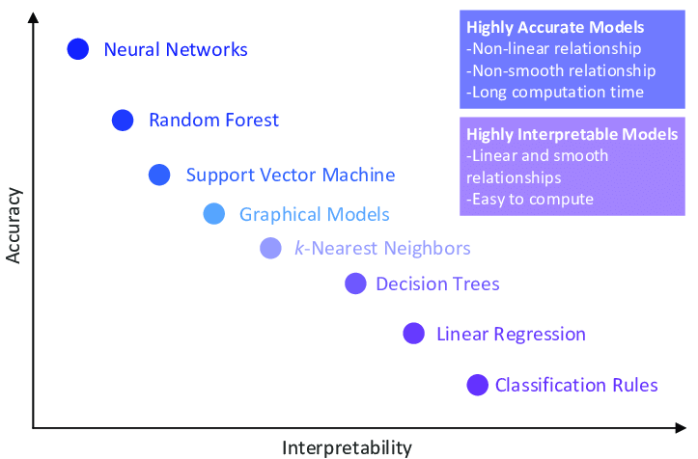
Black-box vs White box models
Source: Morocho-Cayamcela (2019)

Slide 8
Black-box vs White box models
White-box models:
Black-box models:
Logistic Regression
Gaussian Naïve Bayes
Decision Tree
K-Nearest Neighbors
Random Forest
Gradient Boosting
Support Vector Machine
Neural Network

Slide 9
Hypotheses’ Overview
Bc. Petr Nguyen
ngup07@vse.cz

Slide 10
Hypotheses’ Overview
5 hypotheses pertaining to HMEQ data set:
The recalibration of the model enhances model’s performance.
de Hond (2023)
Either KNN or Neural Network model outperforms all the other models.
Aras (2021), Zurada (2014)
Black-box models perform better than white-box models.
Pintelas (2020)
The longer the execution time of a model, the better its performance.
Wu (2018)
The main default drivers are the debt and/or delinquency features.
Zurada (2014)

Slide 11
Machine Learning Implementation Framework
Bc. Petr Nguyen
ngup07@vse.cz

Slide 12
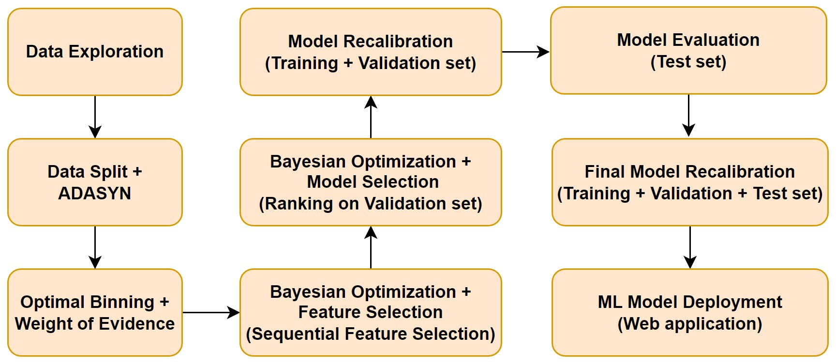
ML Framework
Implementation in Python and HTML/CSS
GitHub repository: https://github.com/petr-ngn/FFU_VSE_Masters_Thesis_ML_Credit_Risk_Modelling

Slide 13
Exploratory Data Analysis
Bc. Petr Nguyen
ngup07@vse.cz

Slide 14
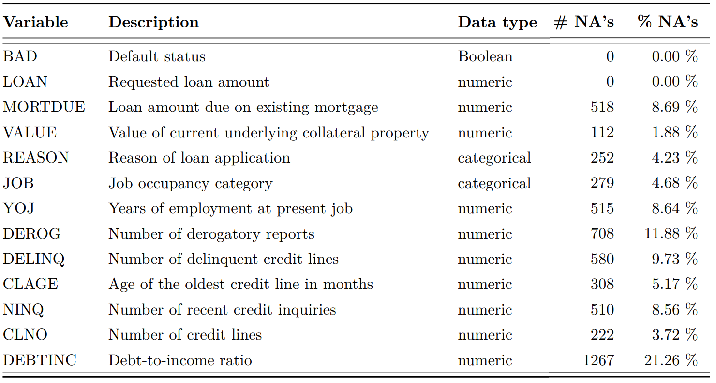
HMEQ Data Set
Application scoring data of US home equity loans from Credit Risk Analytics (Baesens 2016)
5,960 observations
Target variable: default status
12 numeric and categorical features

Slide 15
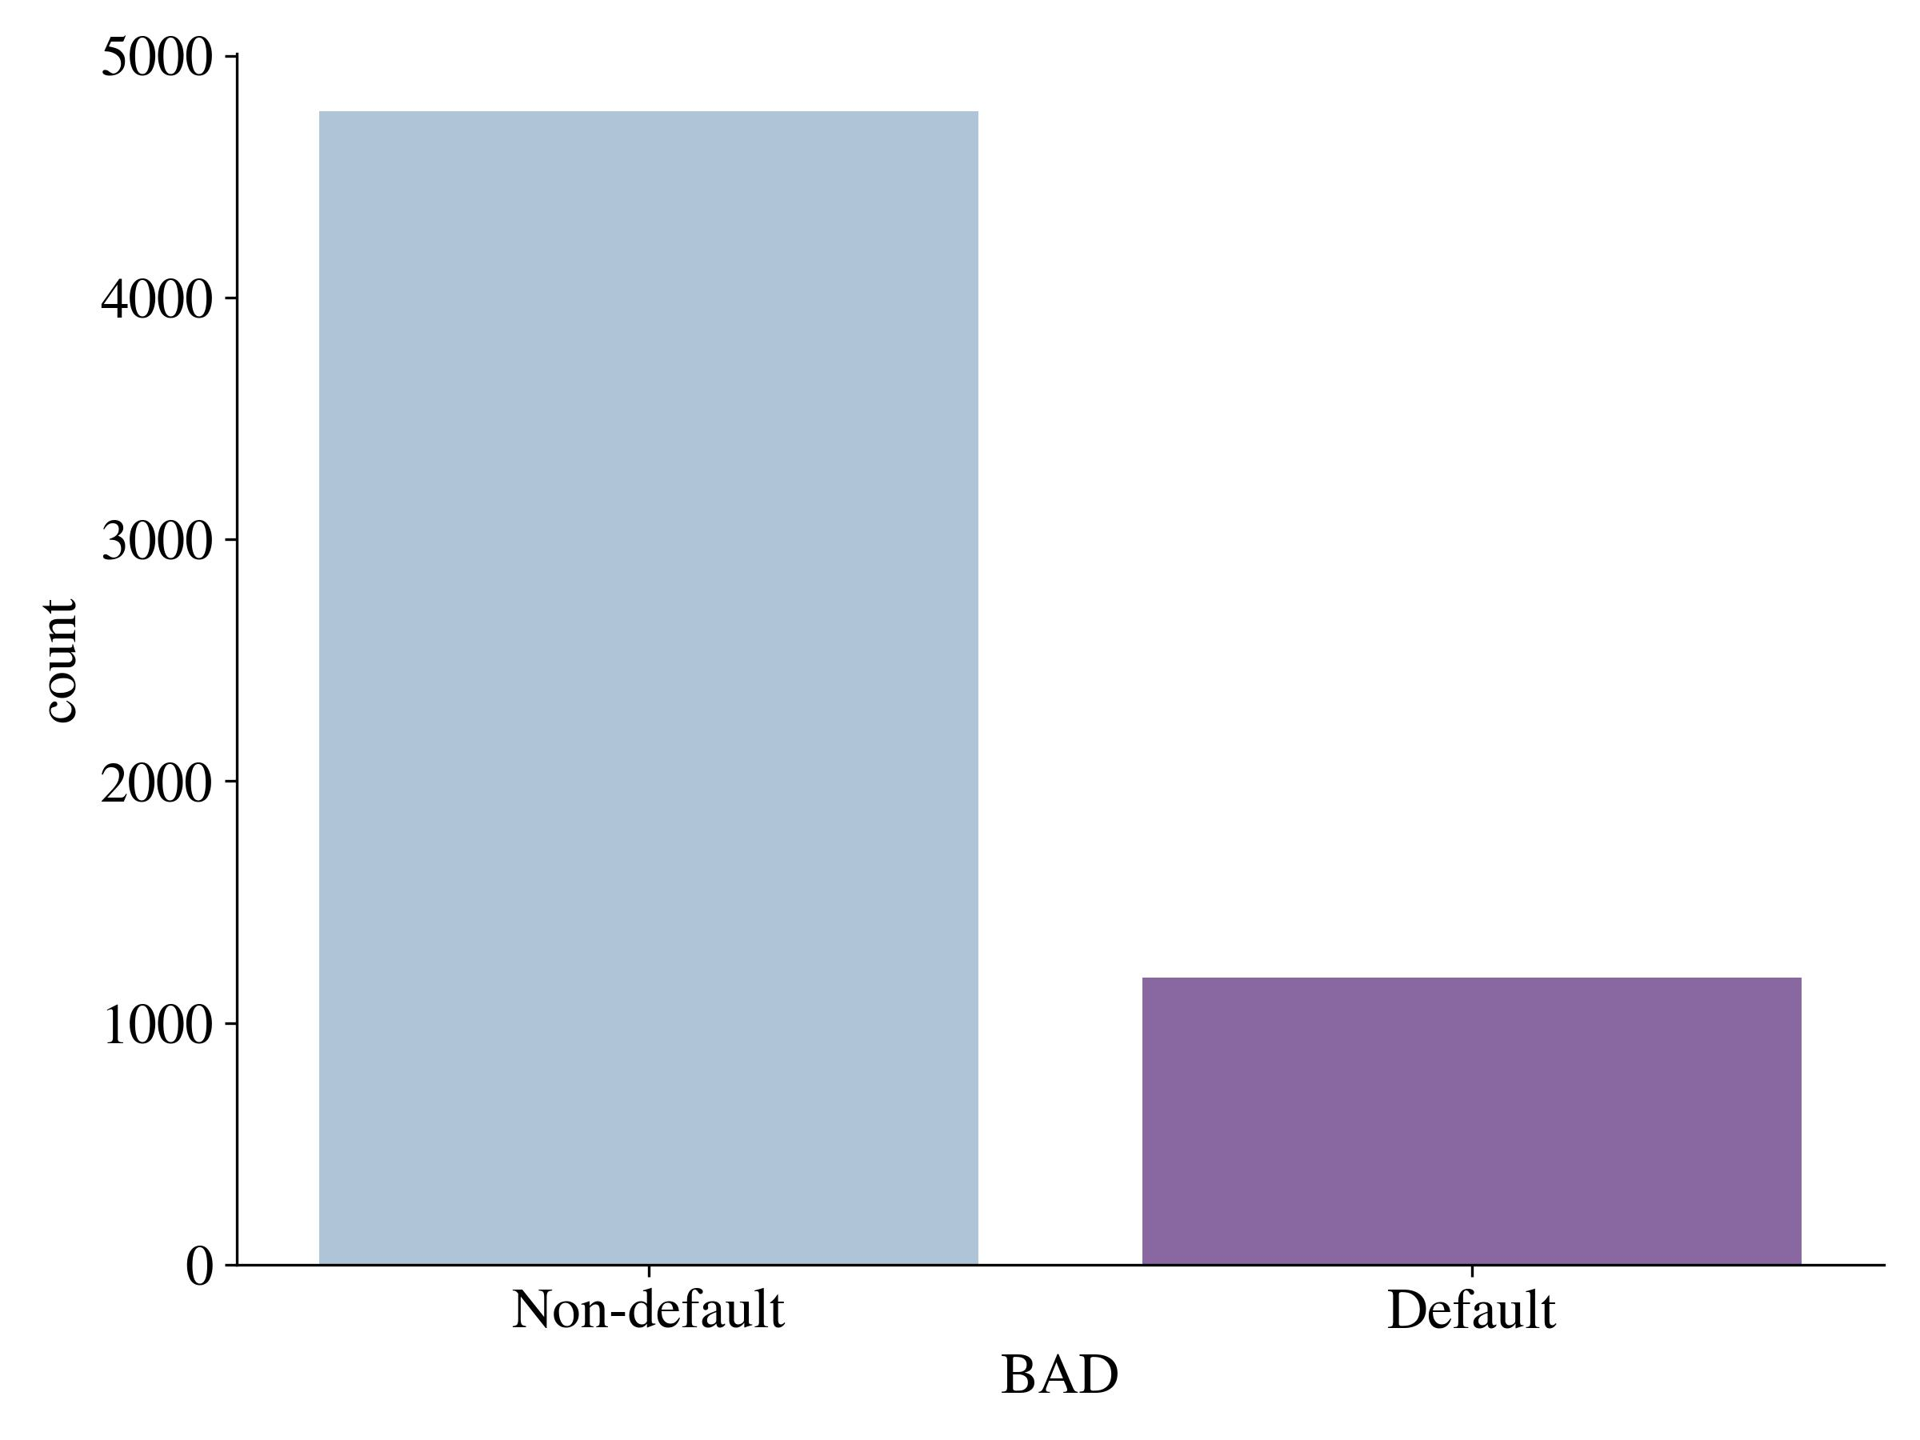
Default Distribution

Slide 16
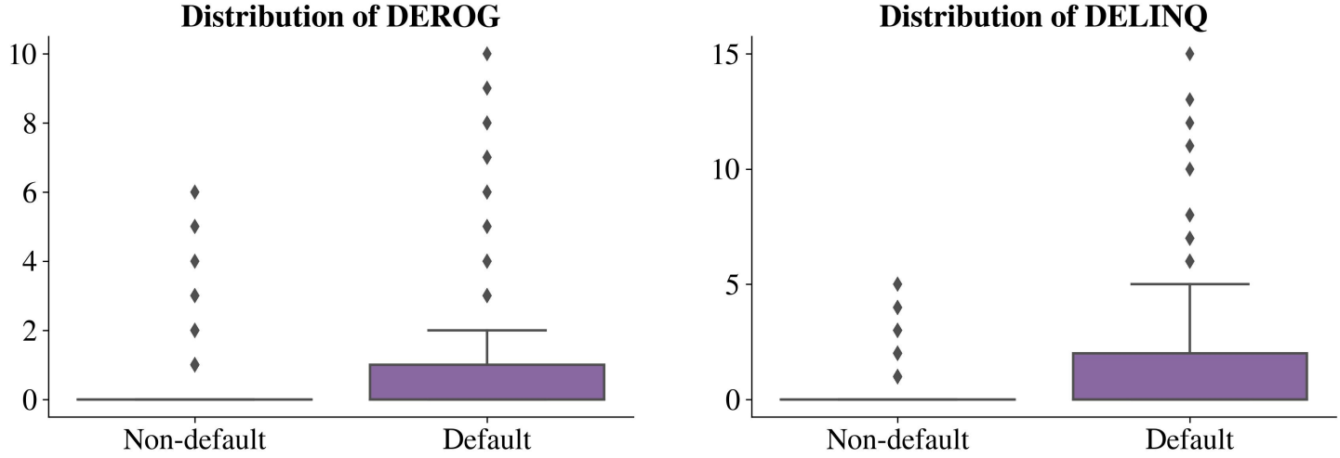
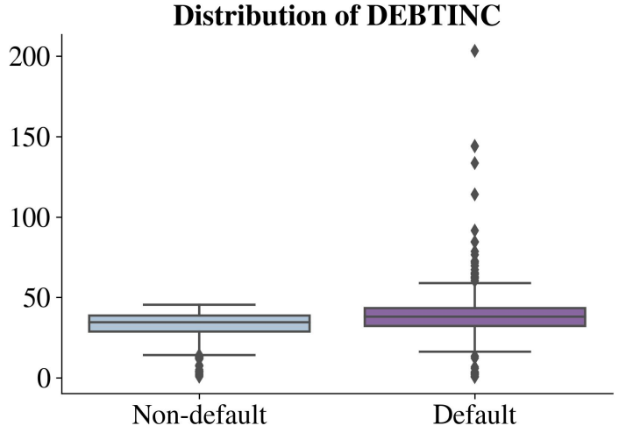
Numerical Features’ Distribution

Slide 17
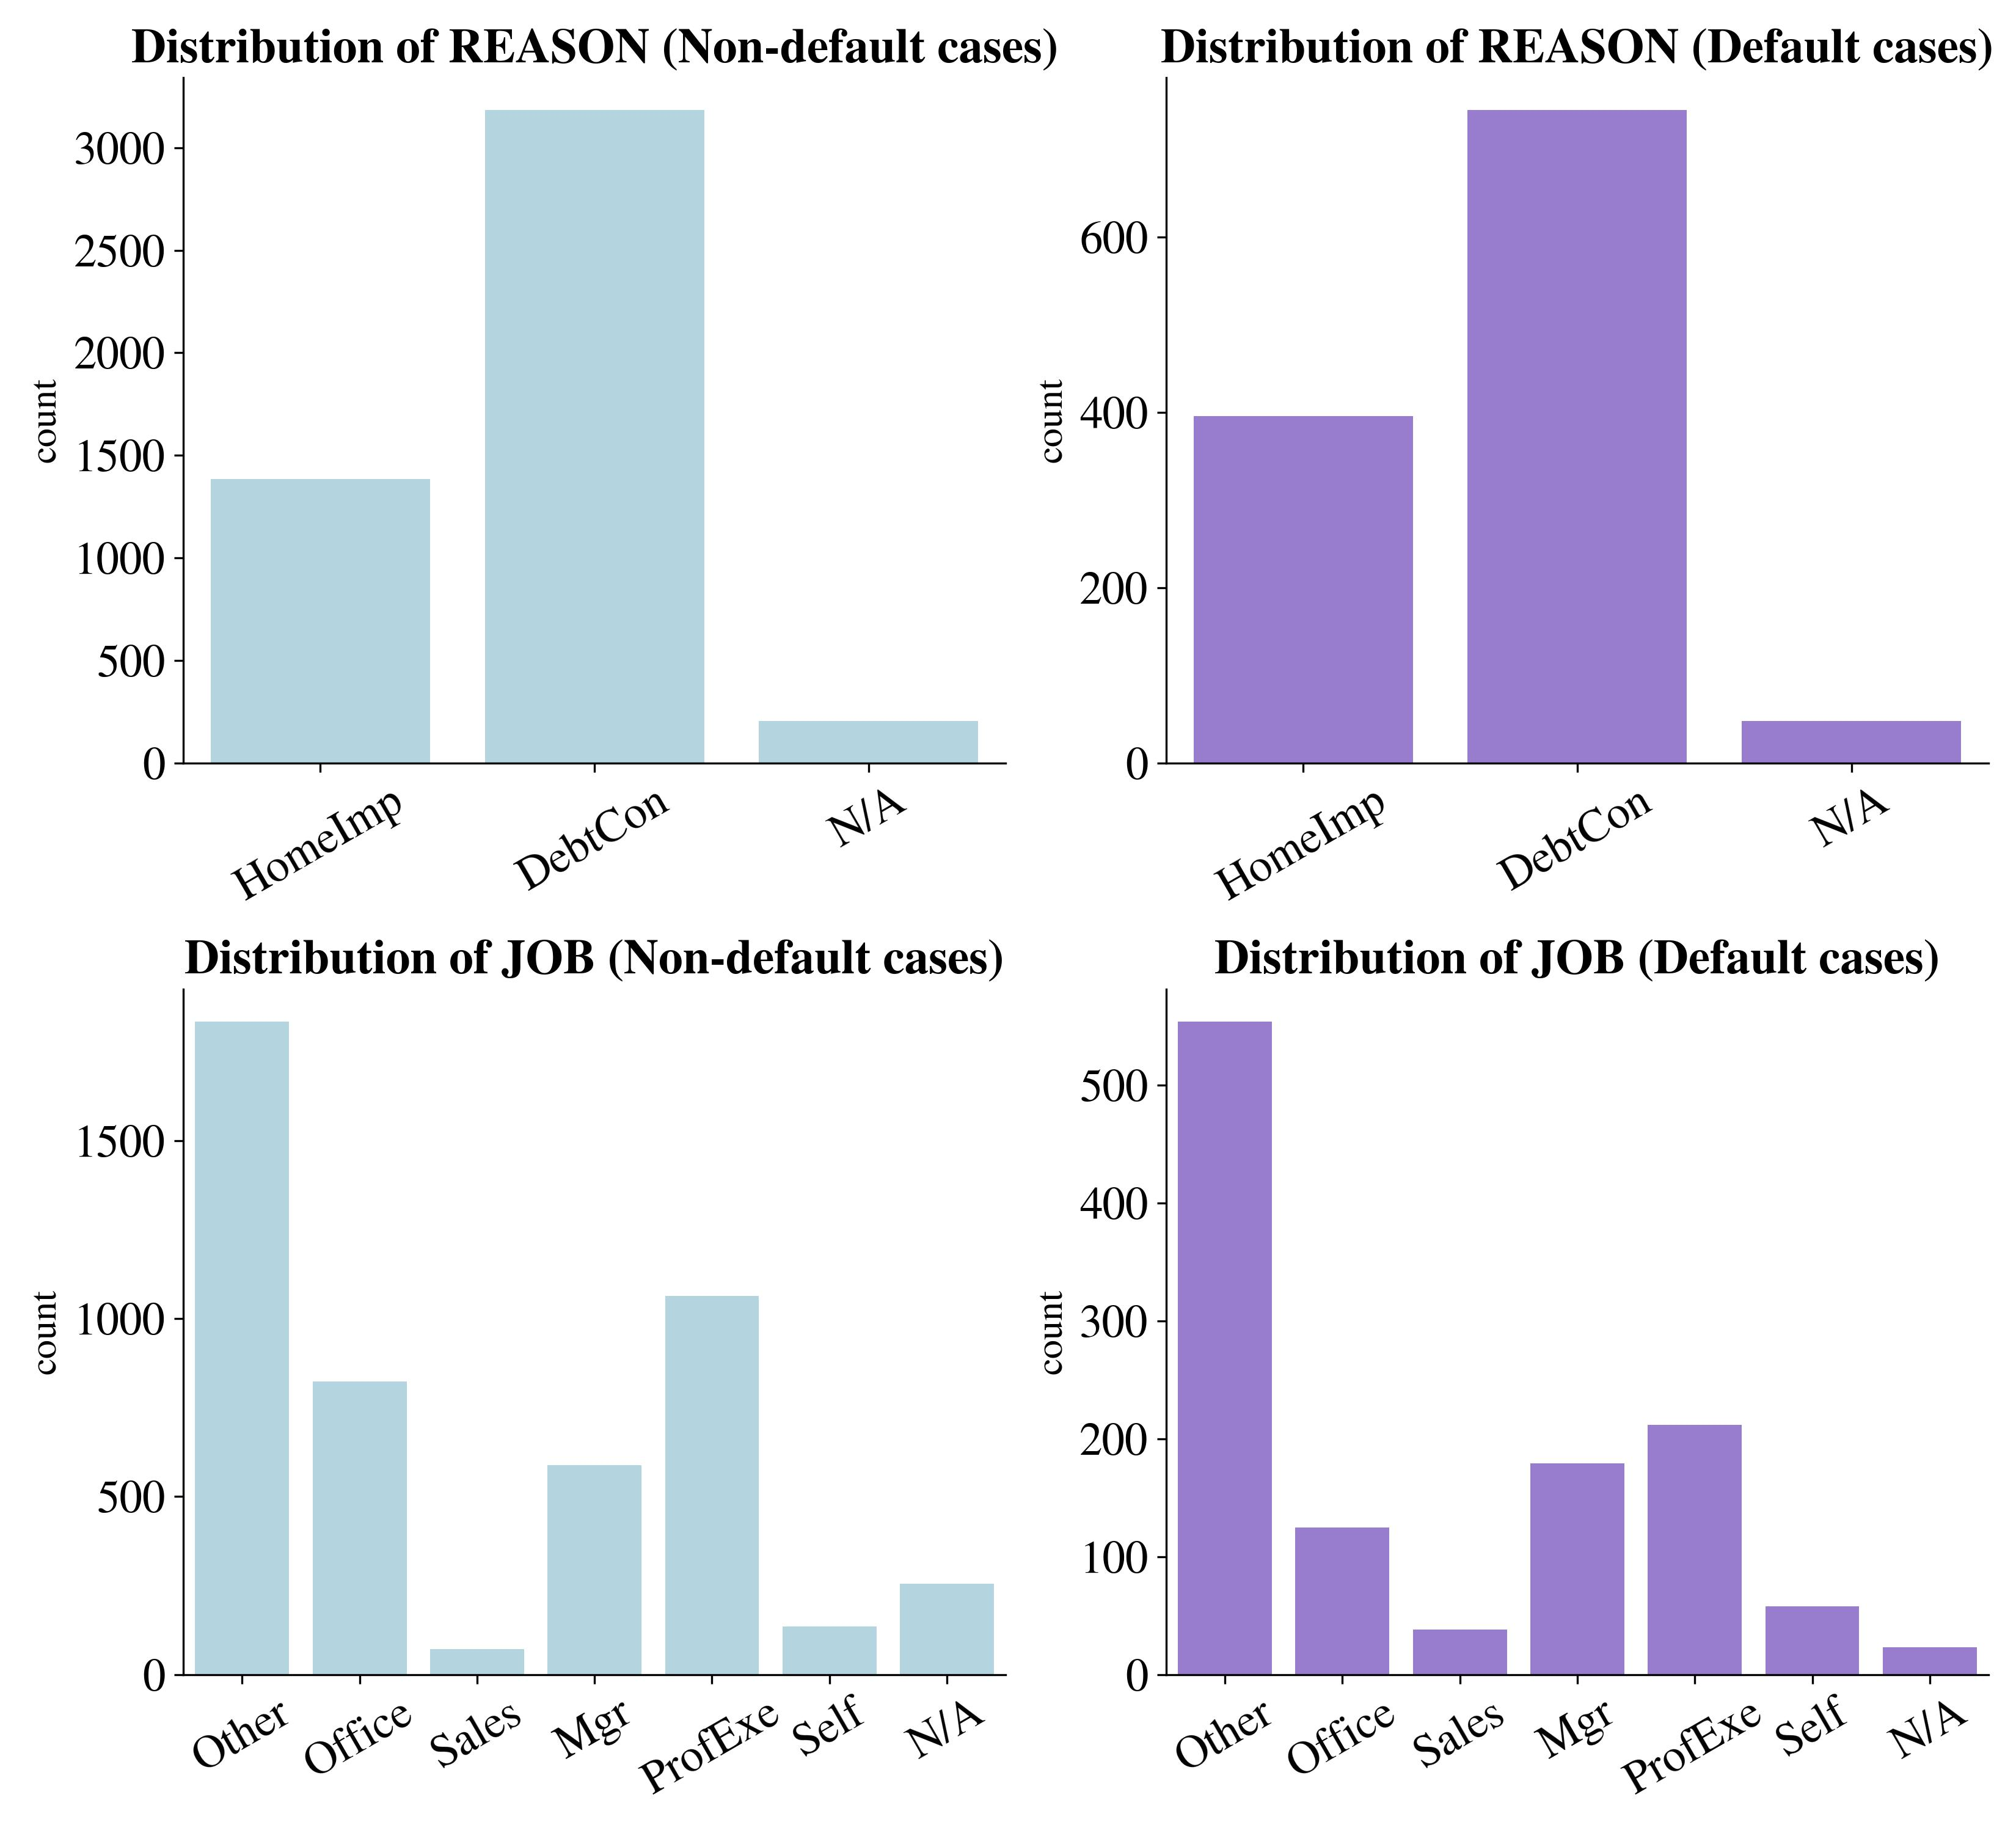
Categorical Features’ Distribution

Slide 18
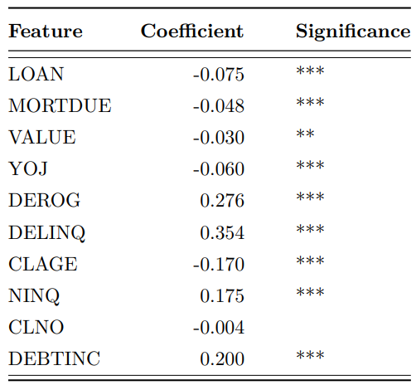
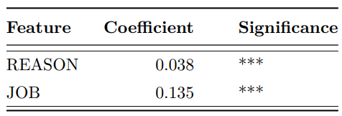
Association Analysis
Numerical Features vs. Default
Point Biserial Correlation
Categorical Features vs. Default
Cramer’s V:

Slide 19
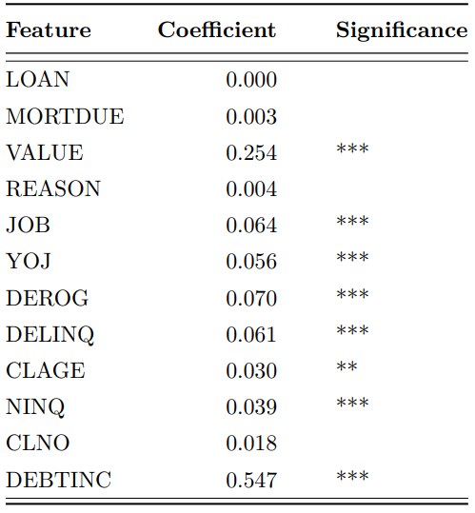
Association Analysis
Features’ Missingness (N/A) vs. Default
Phi Correlation

Slide 20
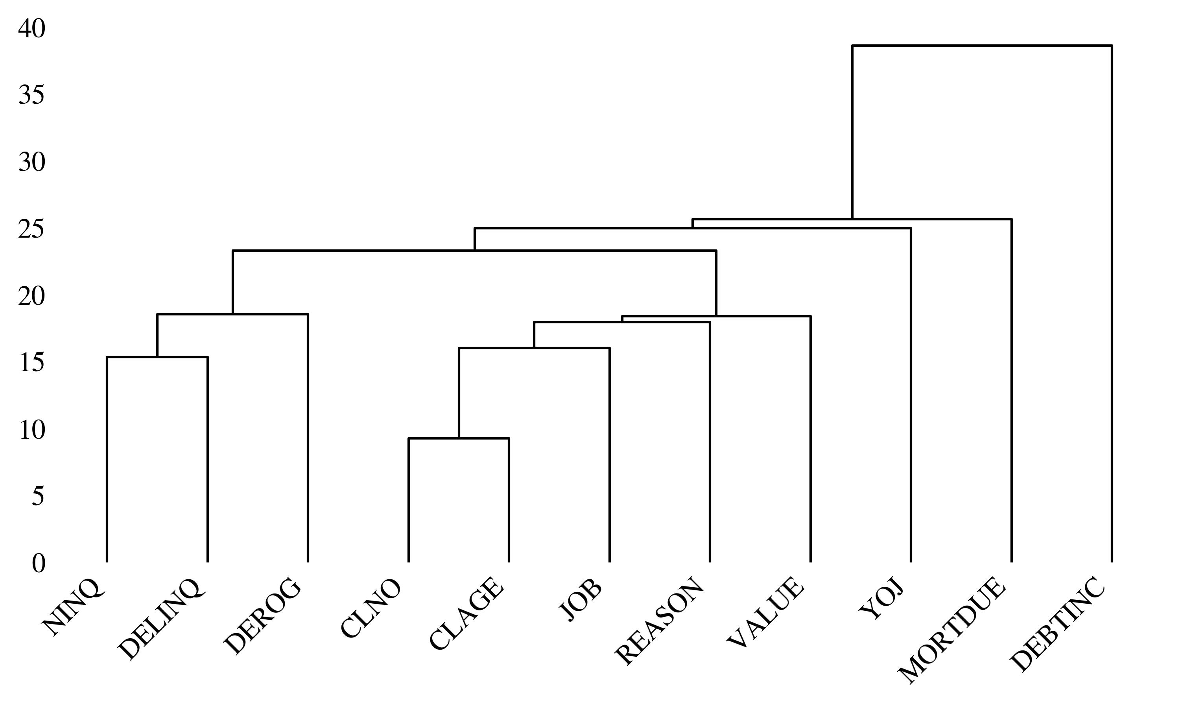
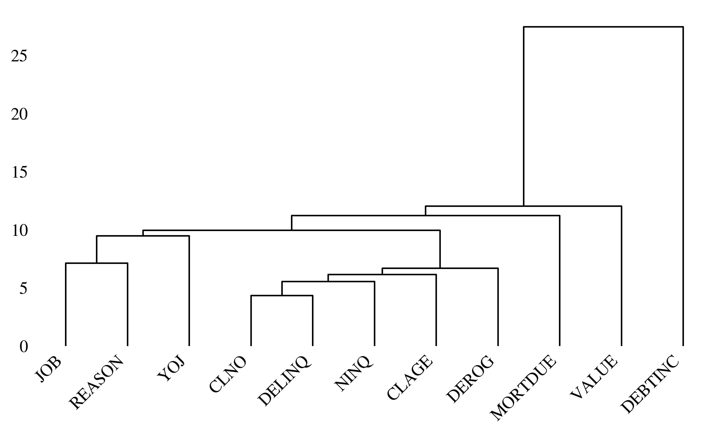
Nullity Dendrogram
All cases:
Default cases:

Slide 21
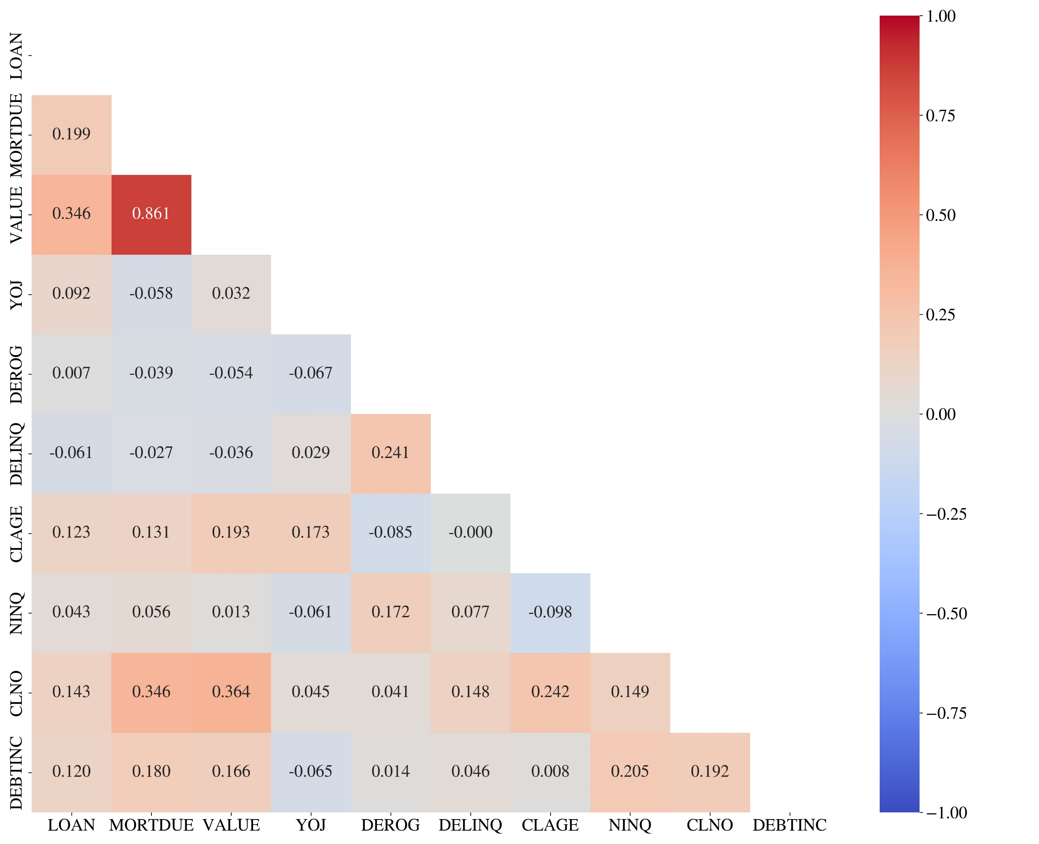
Spearman Correlation Matrix

Slide 22
Data Preprocessing
Bc. Petr Nguyen
ngup07@vse.cz

Slide 23
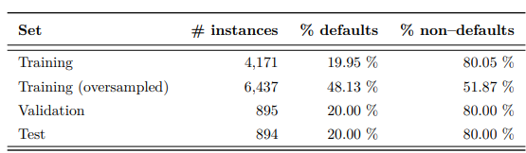
Data Split and ADASYN oversampling
Stratified split into:
Training set (70 %) – Model Training, Hyperparameter tuning, Feature Selection.
Validation set (15 %) – Model Selection.
Test set (15 %) – Model Evaluation.
ADASYN oversampling in order to balance the target distribution
Performed only on training set in order to avoid data leakage
KNN with 5 neighbors and Euclidean distance metric.
No Random Oversampling → Loss of information / No Random Oversampling → Duplications

Slide 24
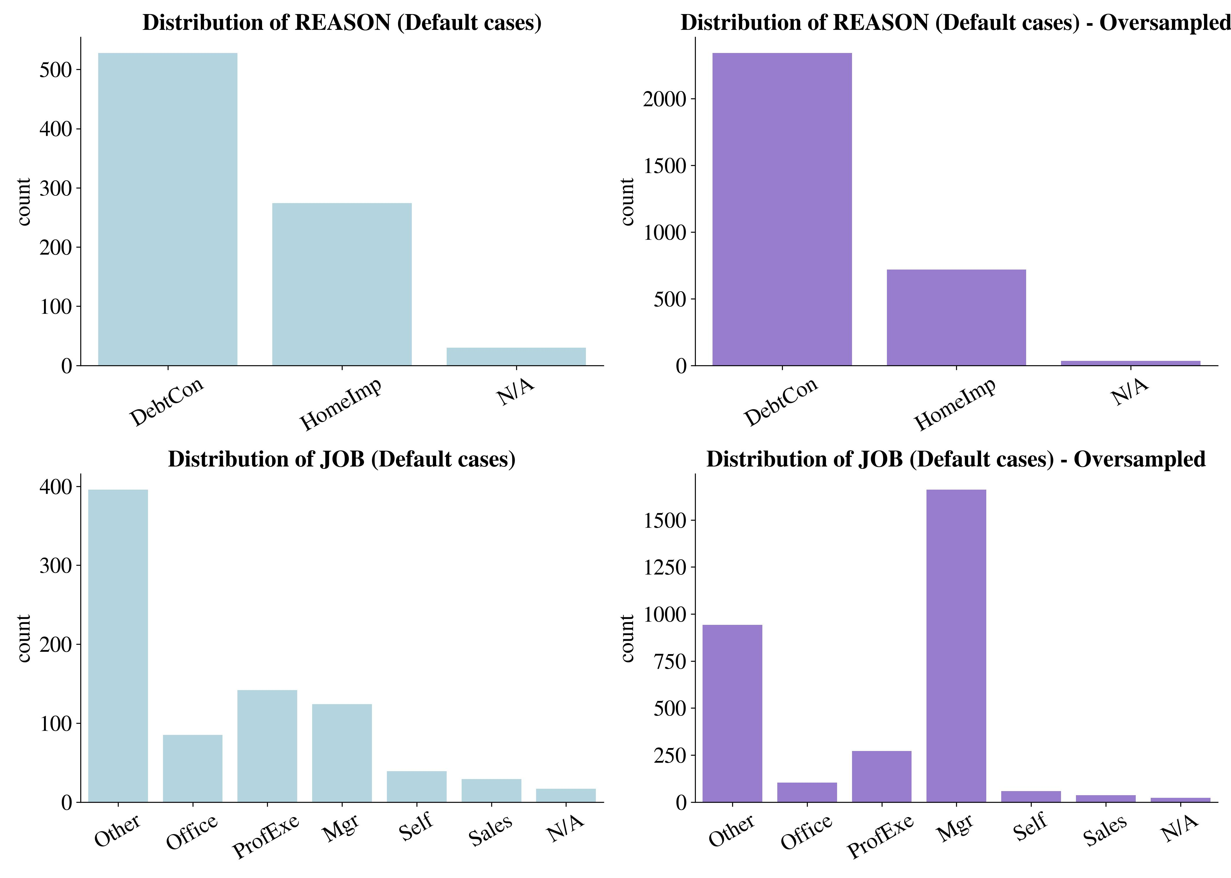
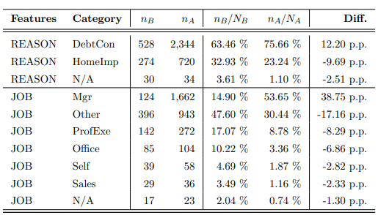
Impact of ADASYN oversampling

Slide 25
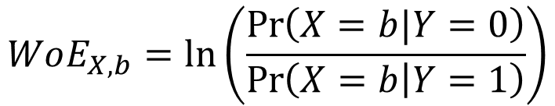
Optimal Binning and WoE transformation
Discretization of numeric features into interval bins and categorical features into sub-category groups, optimally with respect to the target variable.
Captures missing values, outliers and non-linear relationship, thus no imputation/removal is needed
Fitted on training set only (avoidance of data leakage) → transformation of training / validation / test set
Weight-of-Evidence transformation of bins into numeric values:
Positive WoE → Larger distribution of non-defaulters than defaulters
Negative WoE → Larger distribution of defaulters than non-defaulters
$$WoE_{X,b}=\ln\left(\frac{\operatorname{Pr}\left(X=b|Y=0\right)}{\operatorname{Pr}\left(X=b | Y=1\right)}\right)$$

Slide 26
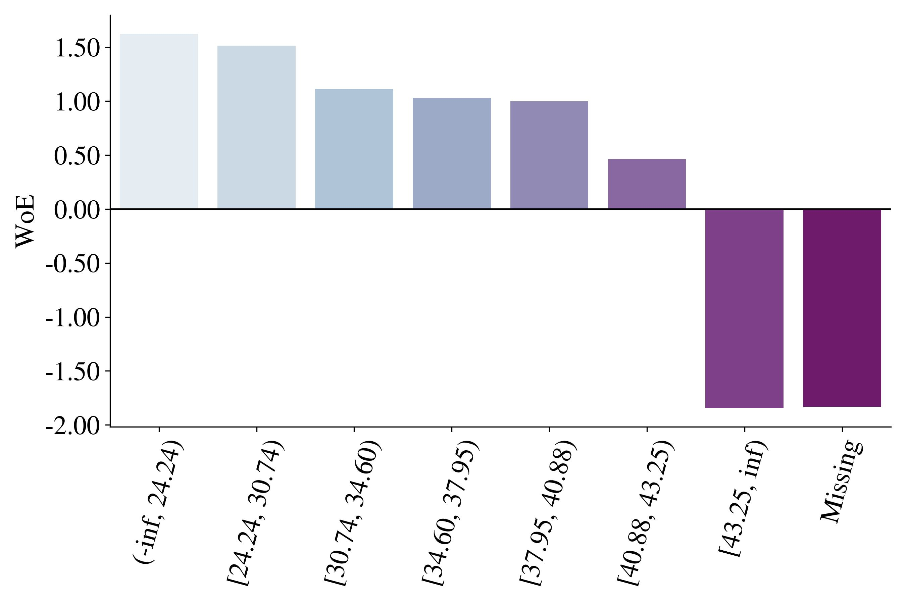
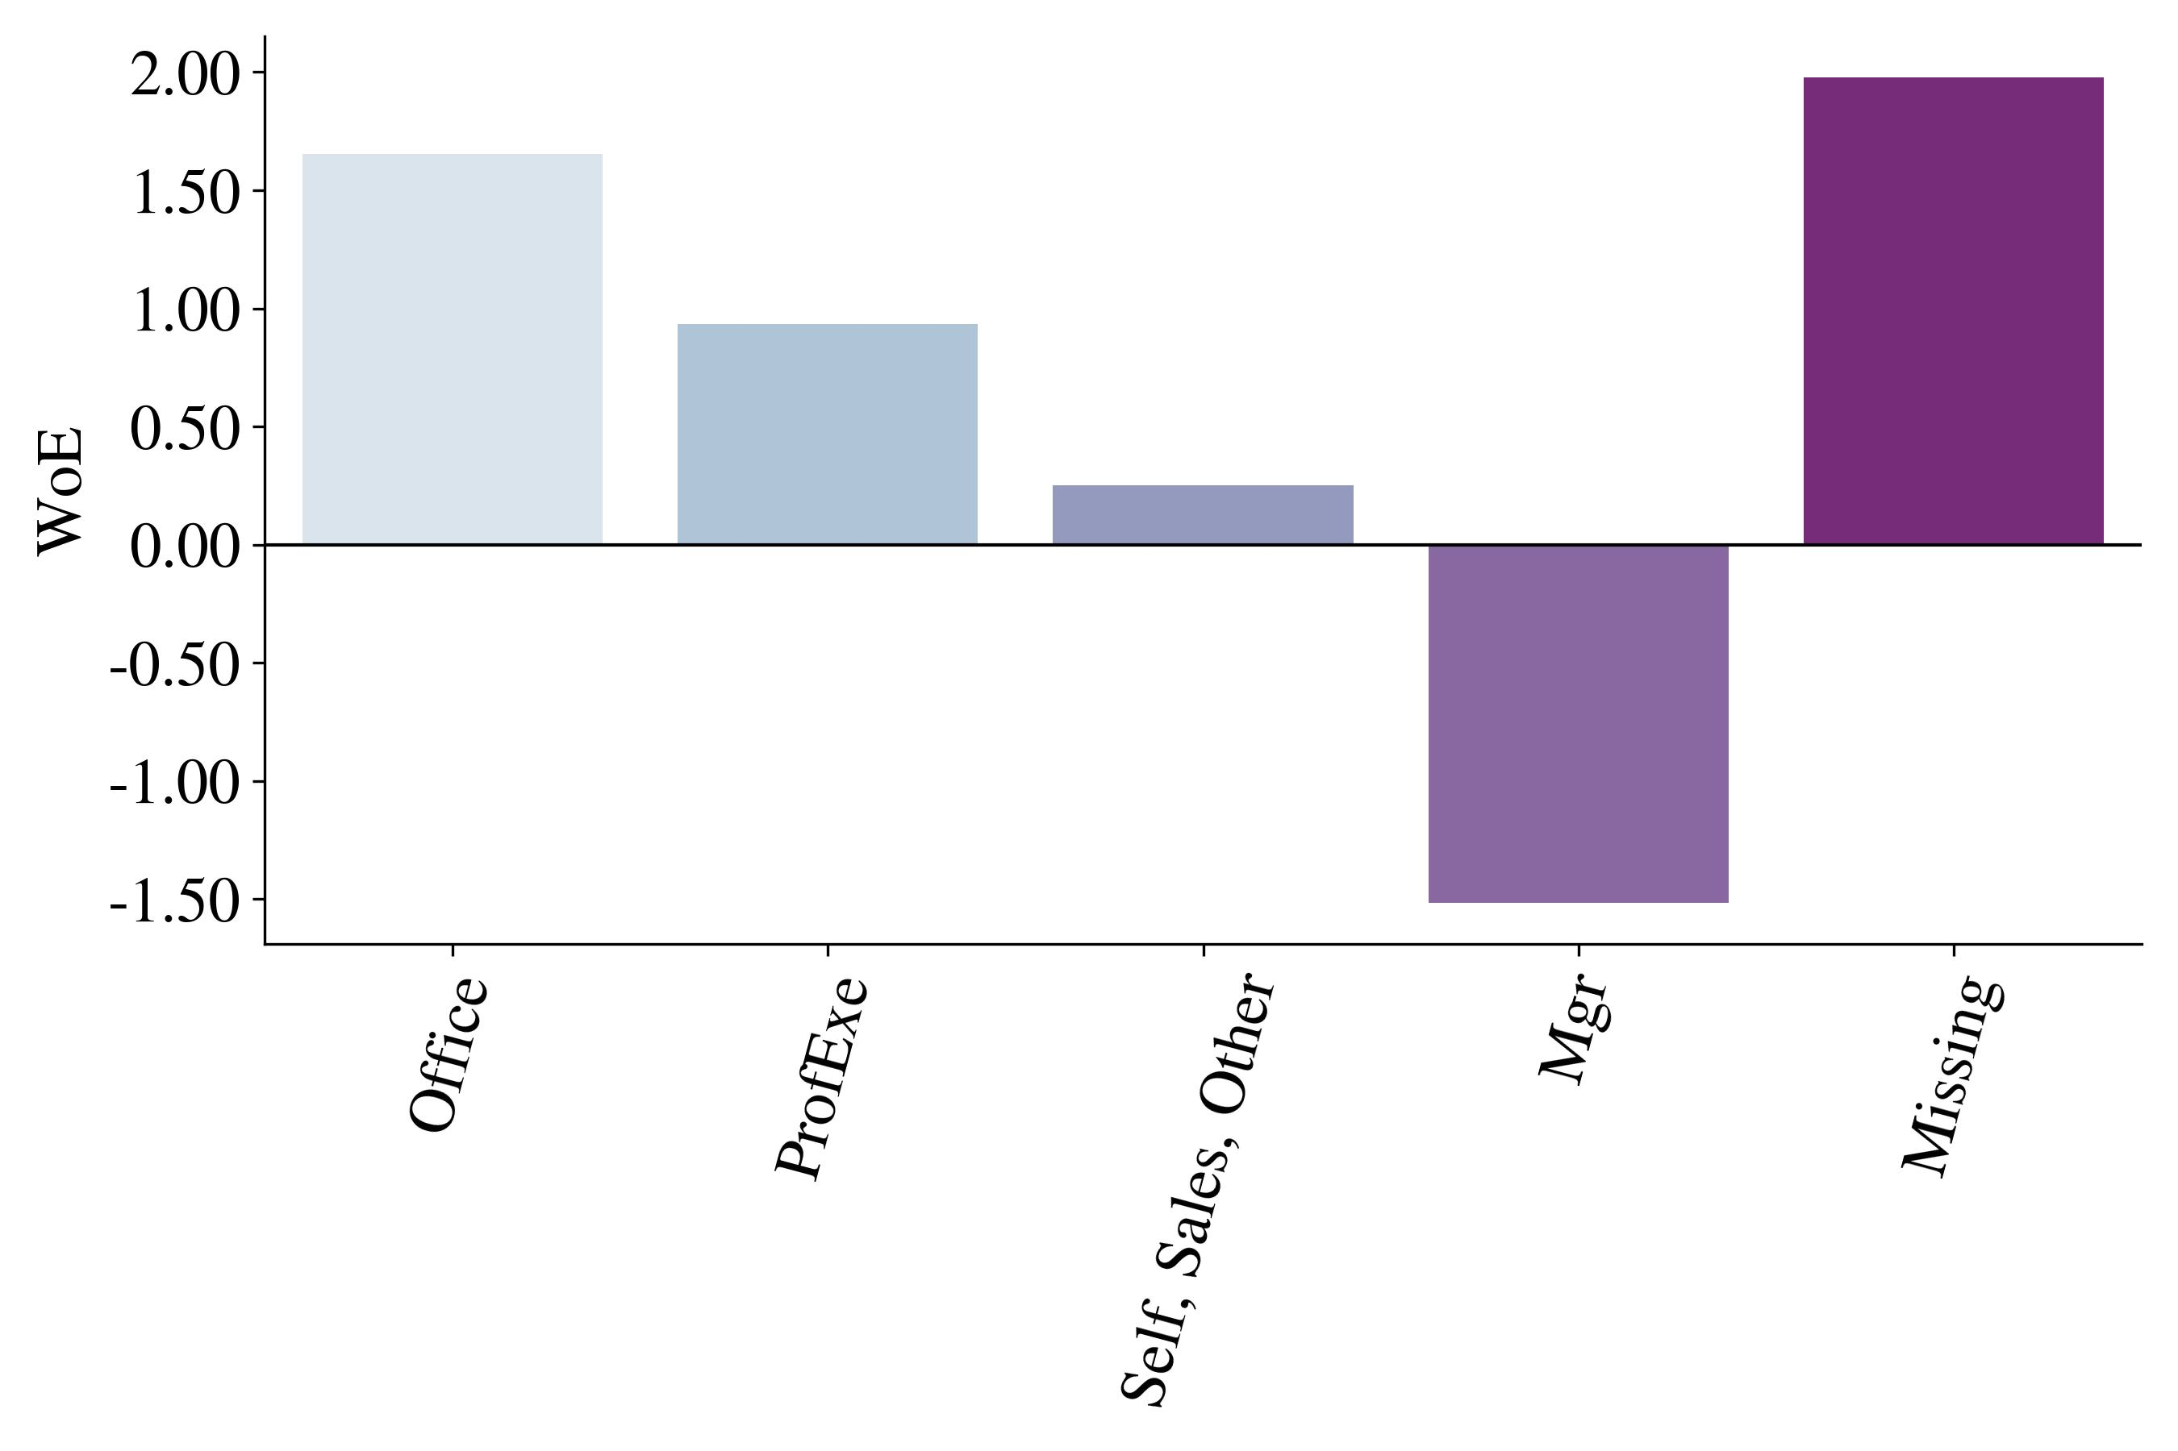
WoE Bins distribution
Debt-to-income ratio
Job occupancy

Slide 27
Bayesian Optimization
Bc. Petr Nguyen
ngup07@vse.cz

Slide 28
Bayesian Optimization
Faster than Grid Search and exhibits better results than Random Search (Drahokoupil 2022).
Bayesian Optimization with:
Stratified 10-fold Cross Validation
Objective function: F1 score
Surrogate function: Gaussian Process

Slide 29
Feature Selection
Bc. Petr Nguyen
ngup07@vse.cz

Slide 30
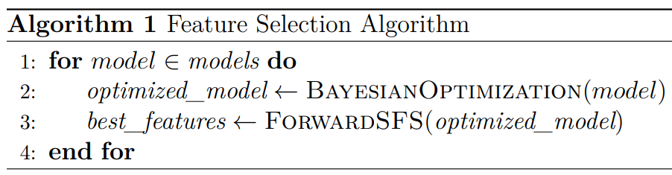
Sequential Feature Selection Algorithm
Custom algorithm developed in Python
Forward Sequential Feature Selection:
Stratified 10-fold Cross Validation
Objective function: F1 score
RFE not used because it requires estimated coefficients / feature importances.
Backward SFS not used because it was more computationally expensive.
Stops when the score is not improved after 2 iterations.
8 models → 8 subsets of optimal features

Slide 31
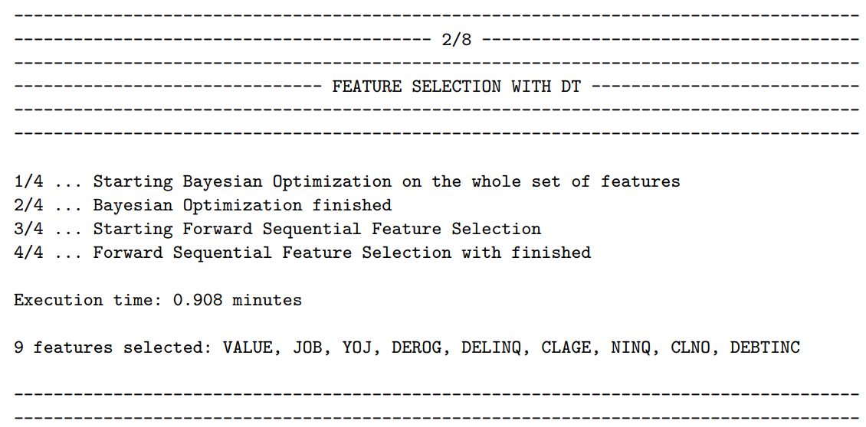
Algorithm Print Statement

Slide 32
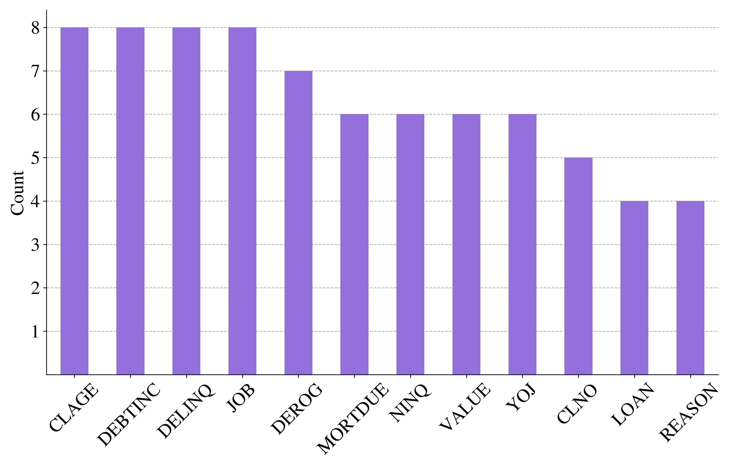
Feature Selection Recurrence

Slide 33
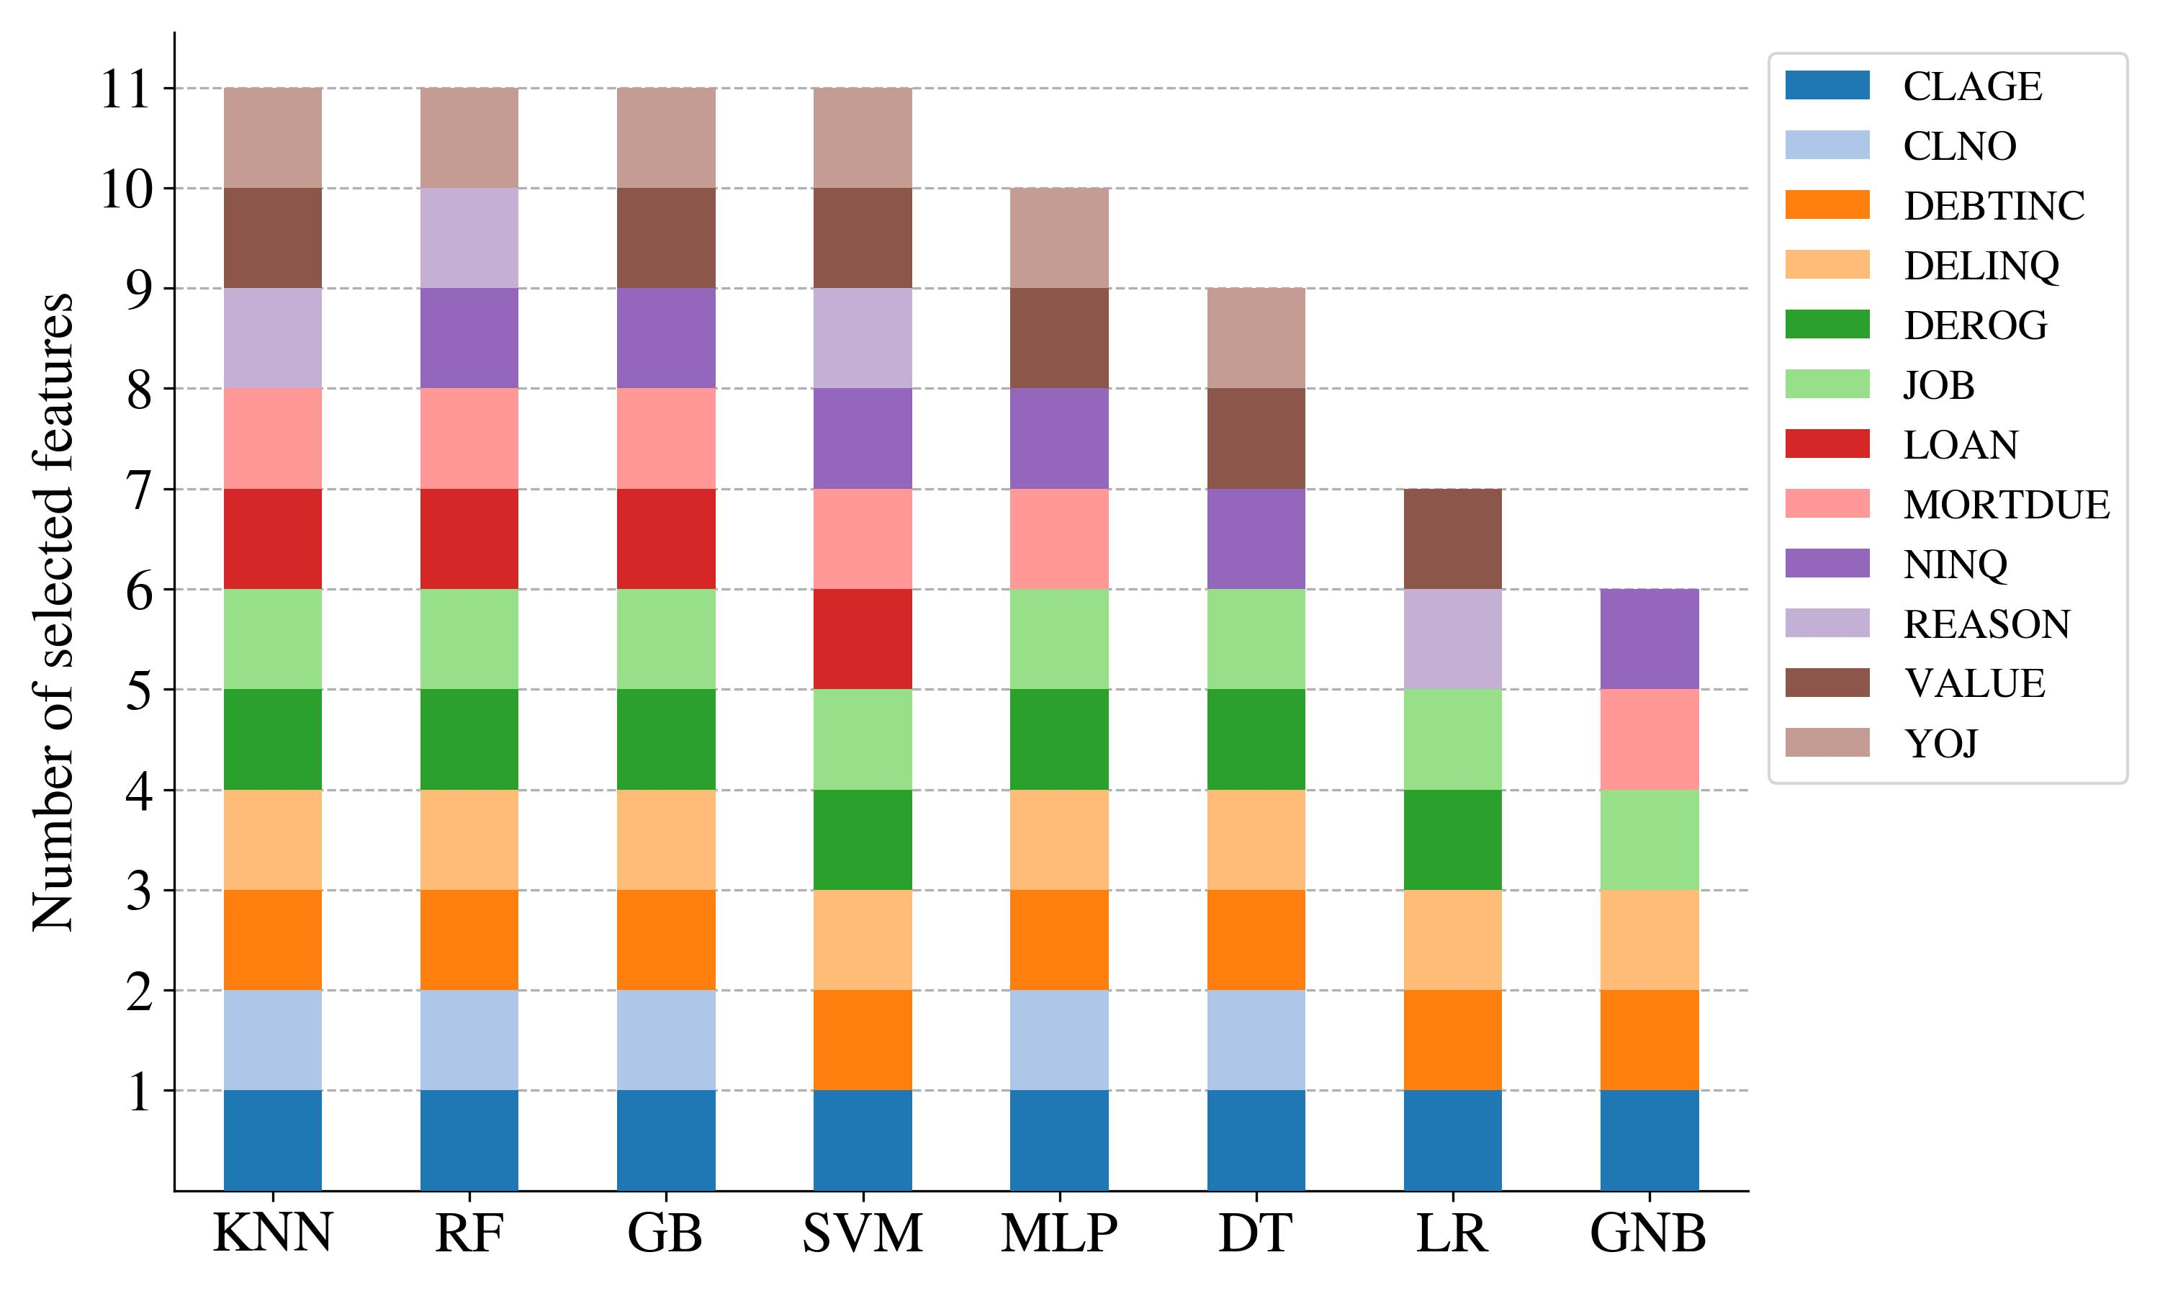
Feature Selection Distribution

Slide 34
Model Selection
Bc. Petr Nguyen
ngup07@vse.cz

Slide 35
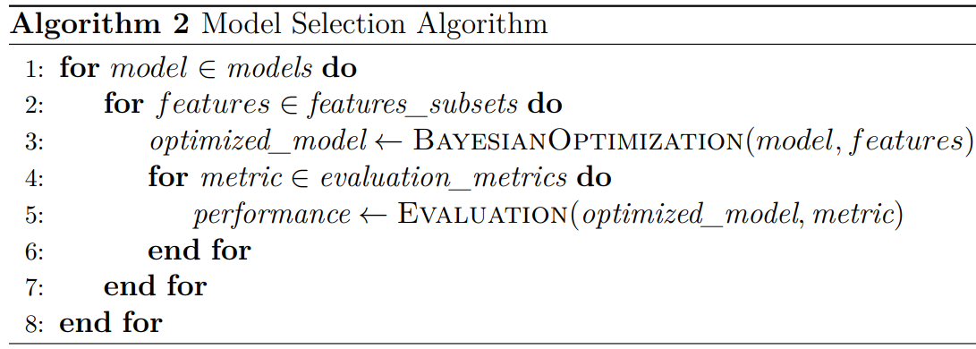
Model Selection Algorithm
Custom algorithm developed in Python
8 models and 8 unique of subset of optimal features →
64 unique models.

Slide 36
Metrics Validation Space
Class-based:
Probability-based:
F1 score
Precision
Recall
Accuracy
Matthew Correlation Coefficient
AUC
Kolmogorov-Smirnov Distance
Somers’ D
Brier Score Loss
Log Loss

Slide 37

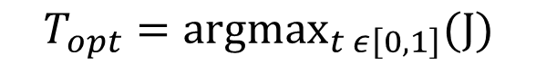
Optimal Threshold Calculation
Youden index:
TPR: True Positive Rate
TNR: True Negative Rate
$$J=TPR+TNR+1$$
$$T_{opt}={argmax}_{t ε\left[0,1\right]}(J)$$

Slide 38
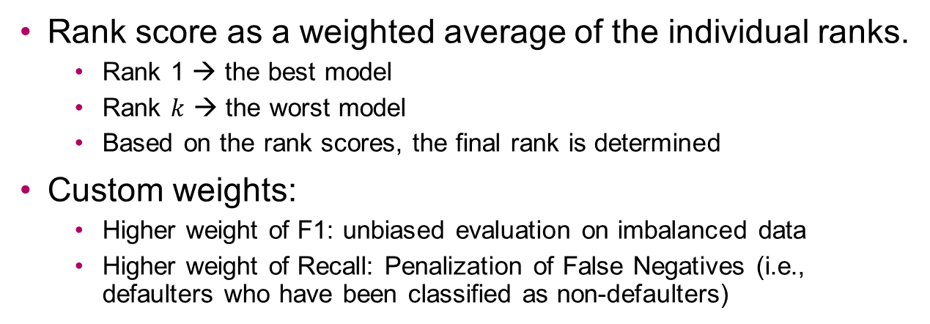
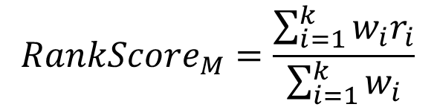
Model Weighted Ranking
Rank score as a weighted average of the individual ranks.
Rank 1 → the best model
Rank $k$ → the worst model
Based on the rank scores, the final rank is determined
Custom weights:
Higher weight of F1: unbiased evaluation on imbalanced data
Higher weight of Recall: Penalization of False Negatives (i.e., defaulters who have been classified as non-defaulters)
Metric | Weight
F1 | 1.5
Recall | 1.2
Precision | 1
Accuracy | 1
MCC | 1
AUC | 1
KS | 1
Somers’ D | 1
Brier Loss | 1
Log Loss | 1
$$RankScore_{M}=\frac{\sum_{i=1}^{k}{w_{i}r_{i}}}{\sum_{i=1}^{k}{w_{i}}}$$

Slide 39
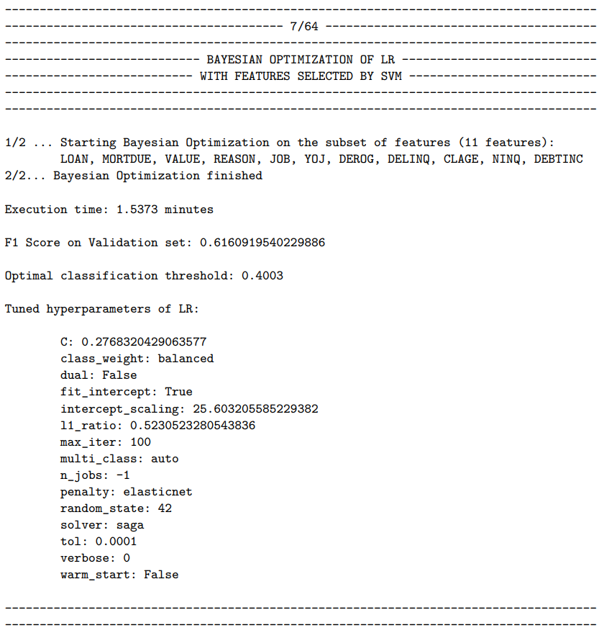
Algorithm Print Statement

Slide 40
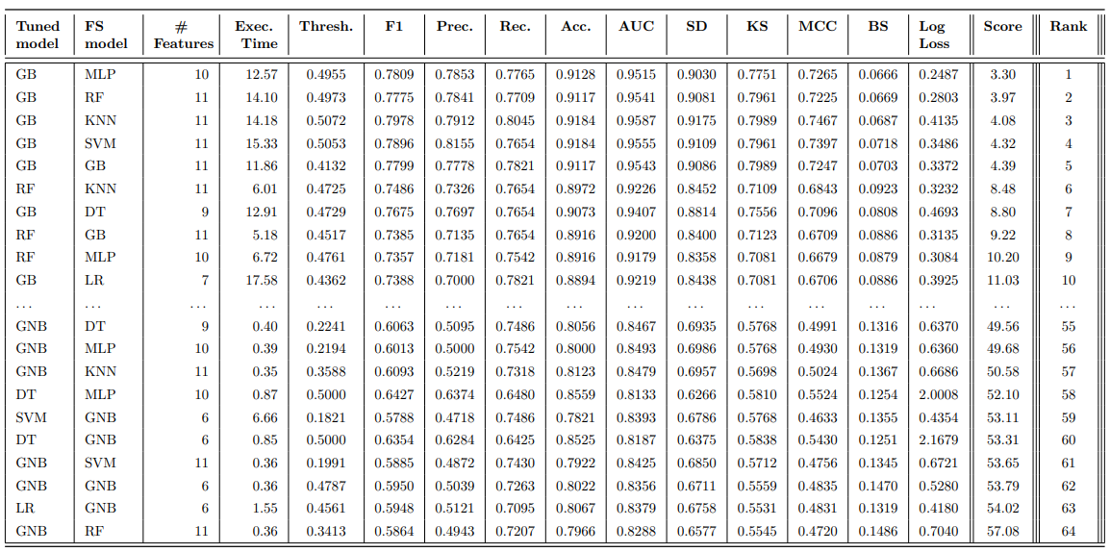
Model Selection Results

Slide 41
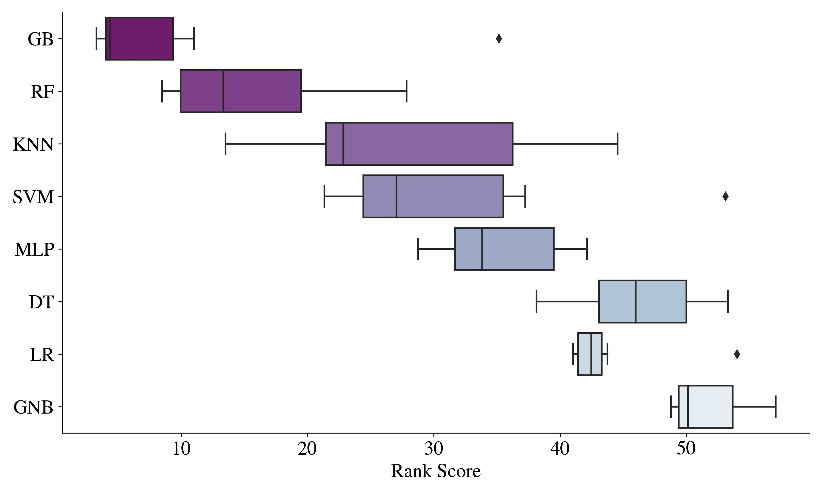
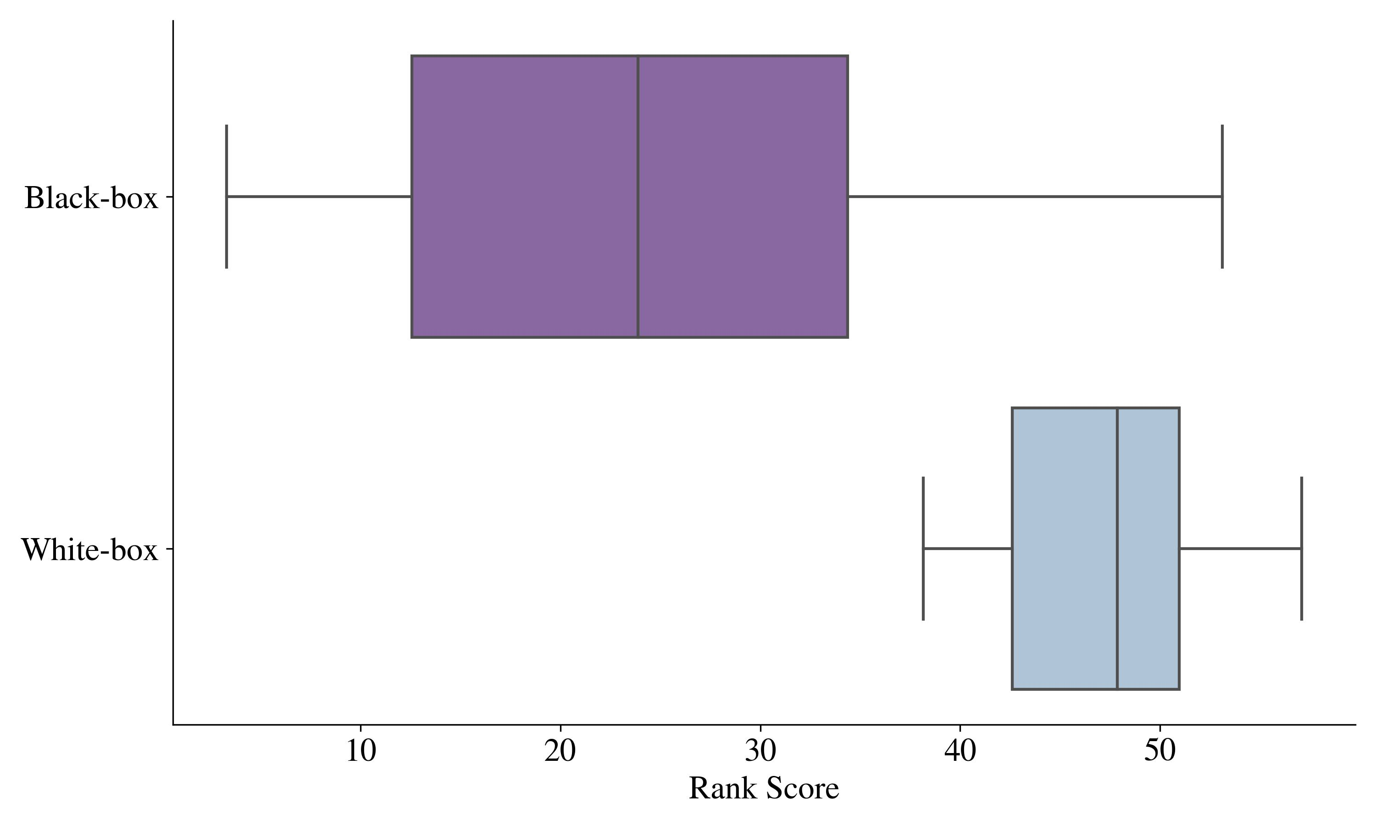
Rank Scores Distribution

Slide 42
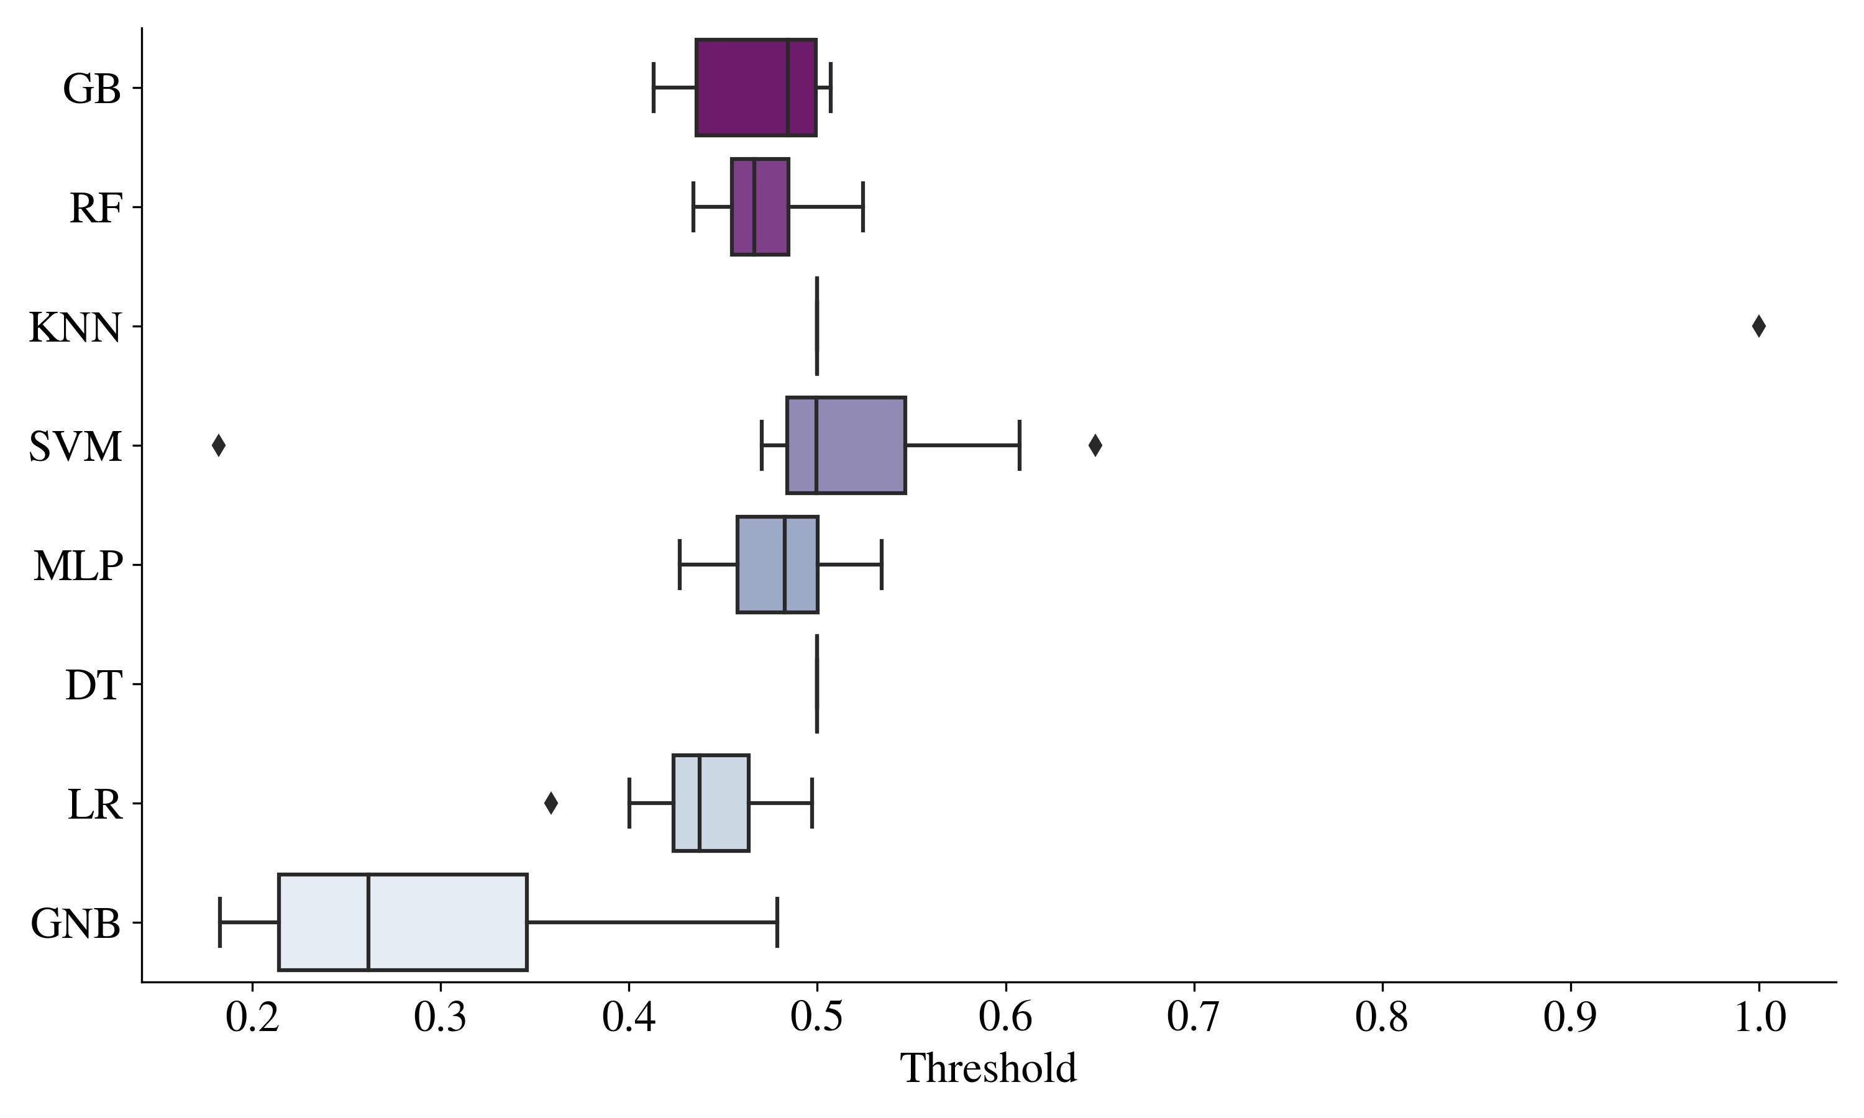
Threshold Distribution

Slide 43
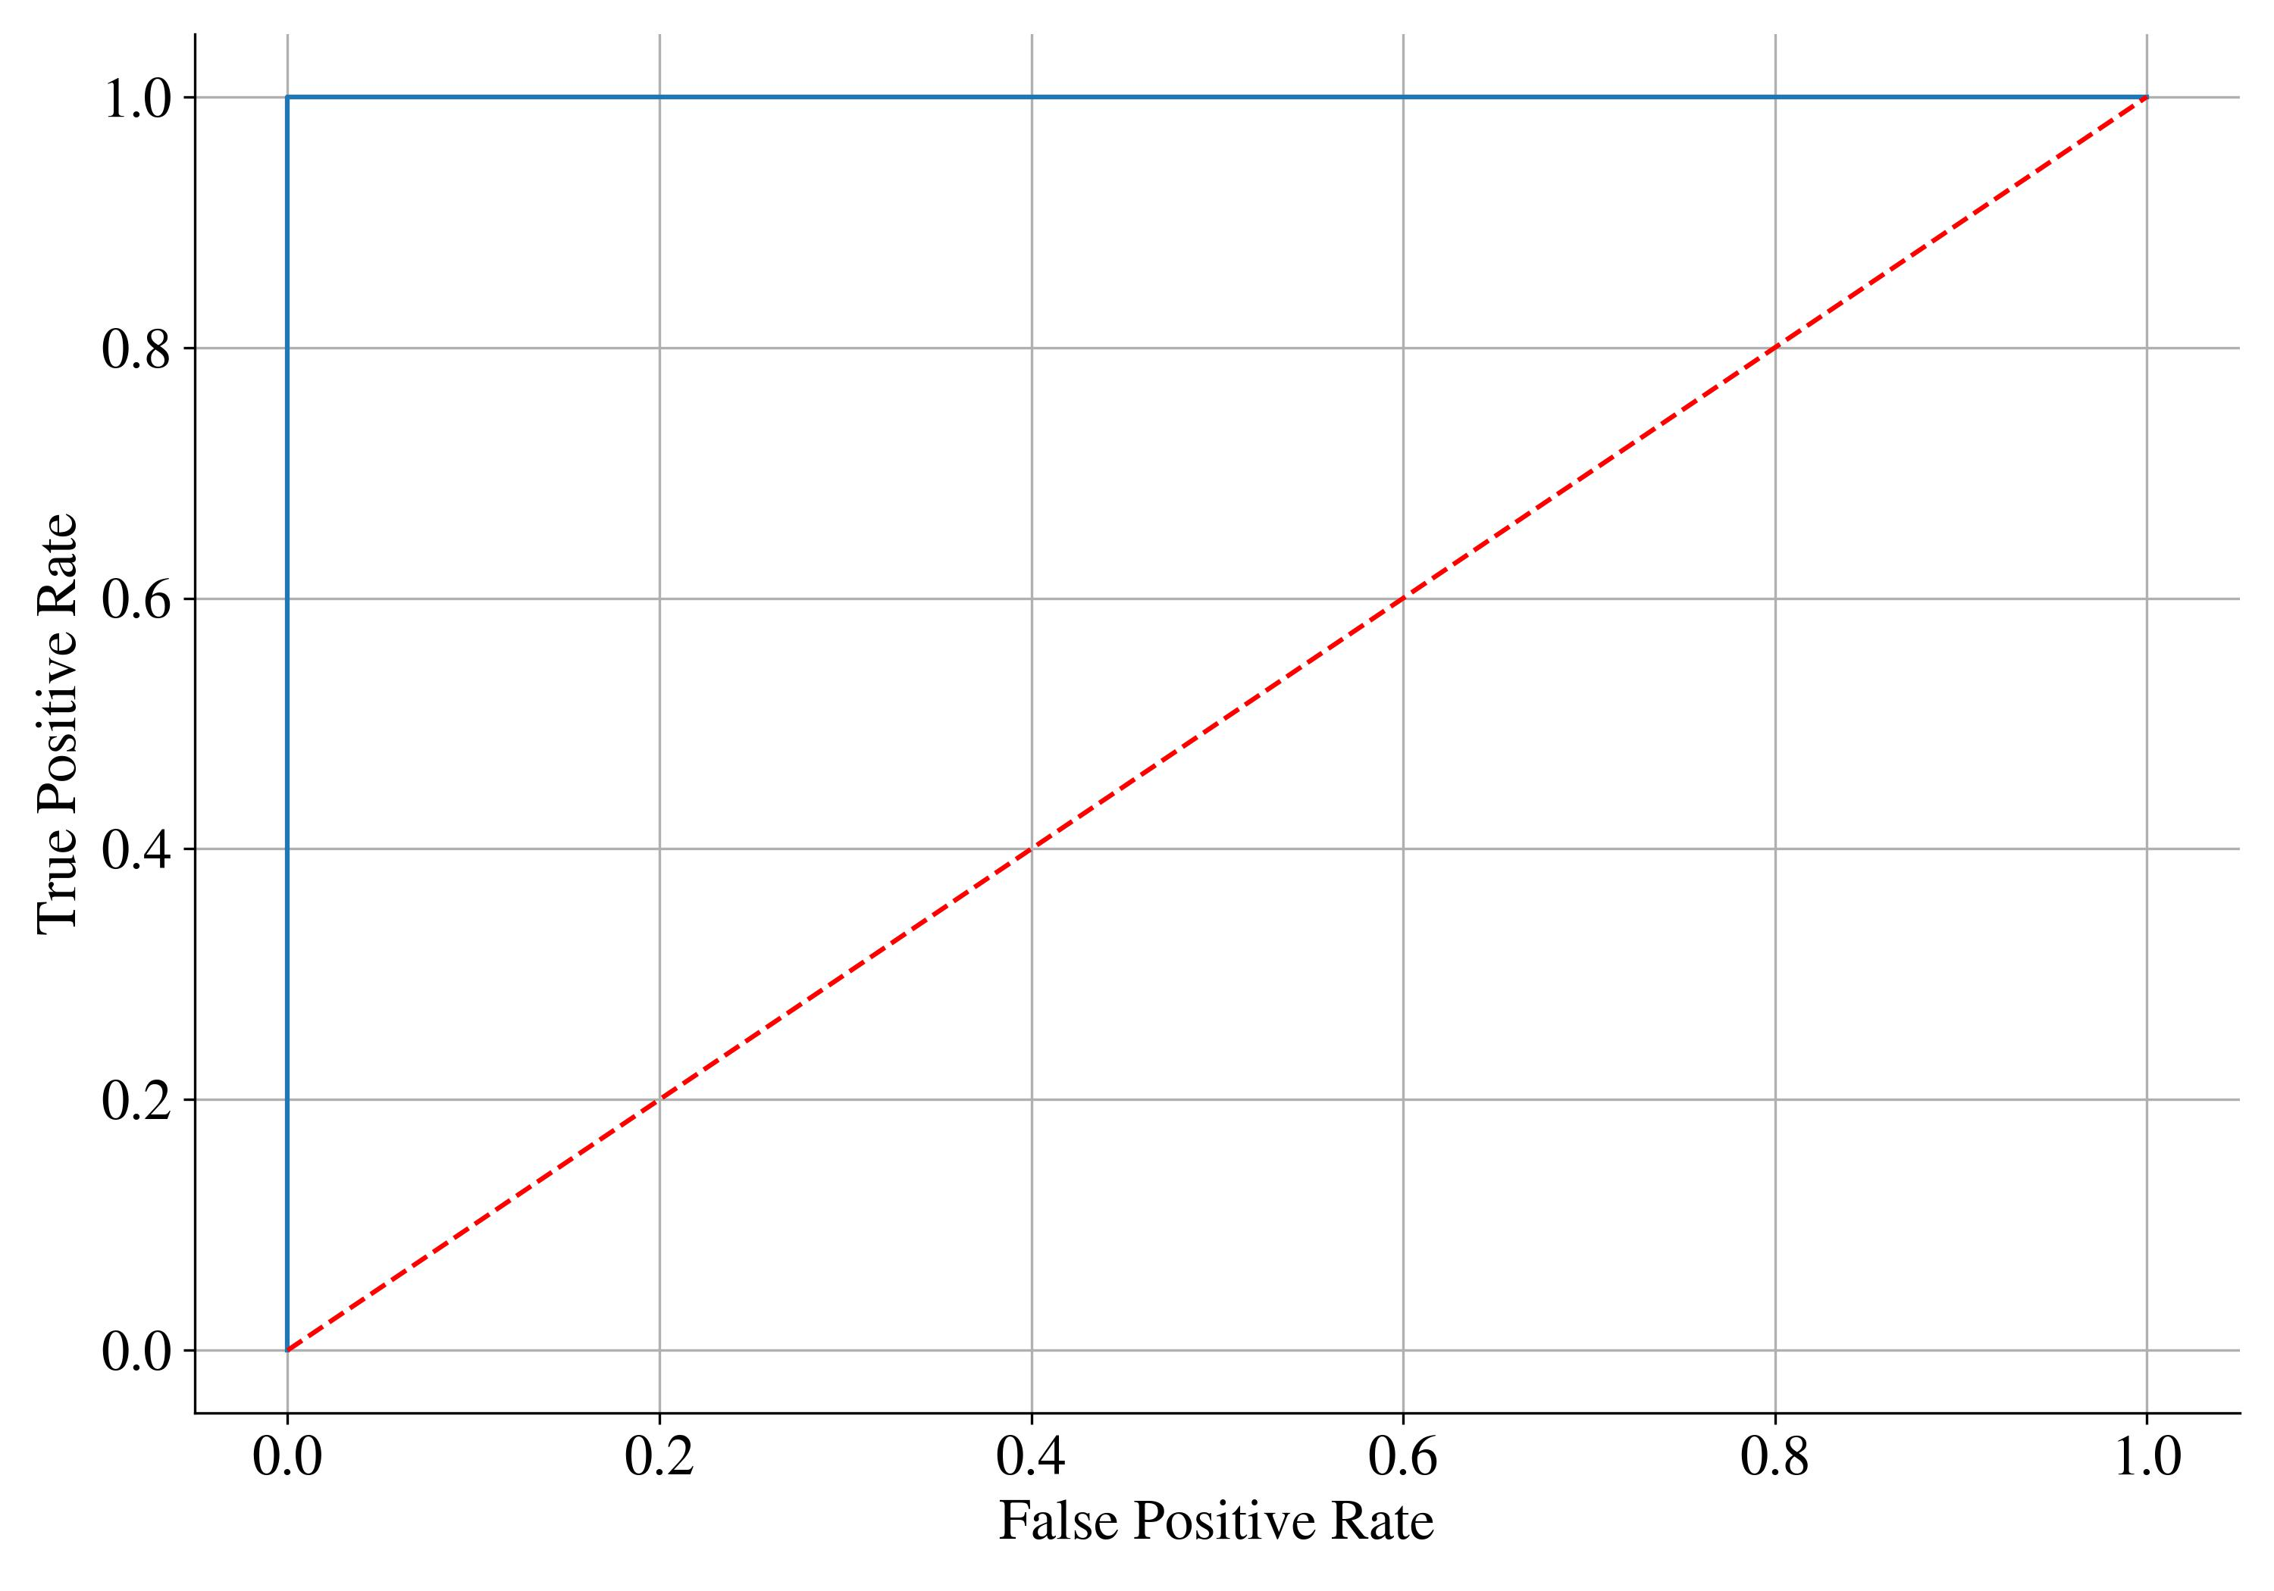
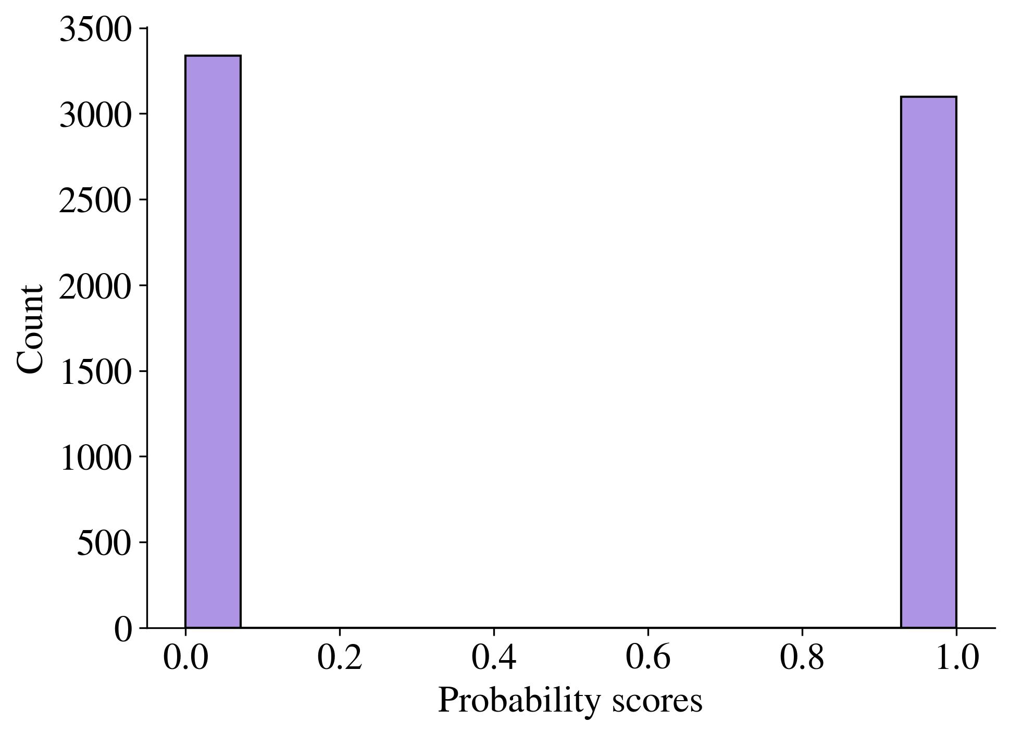
KNN Special Case
Probability Score Distribution
ROC Curve

Slide 44
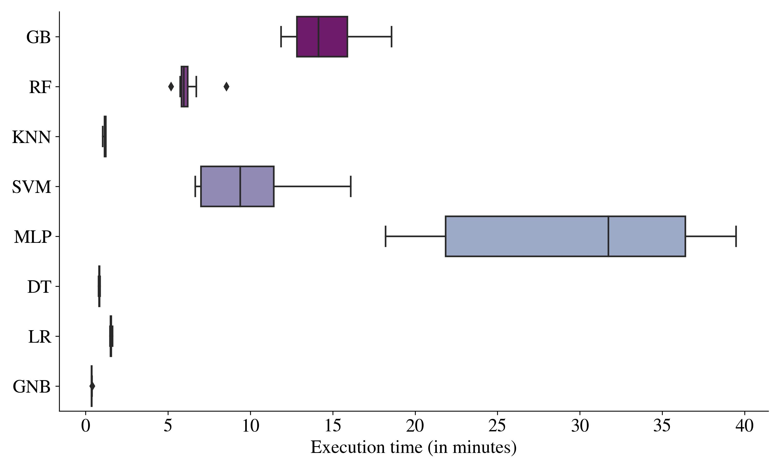
Execution Time Distribution

Slide 45
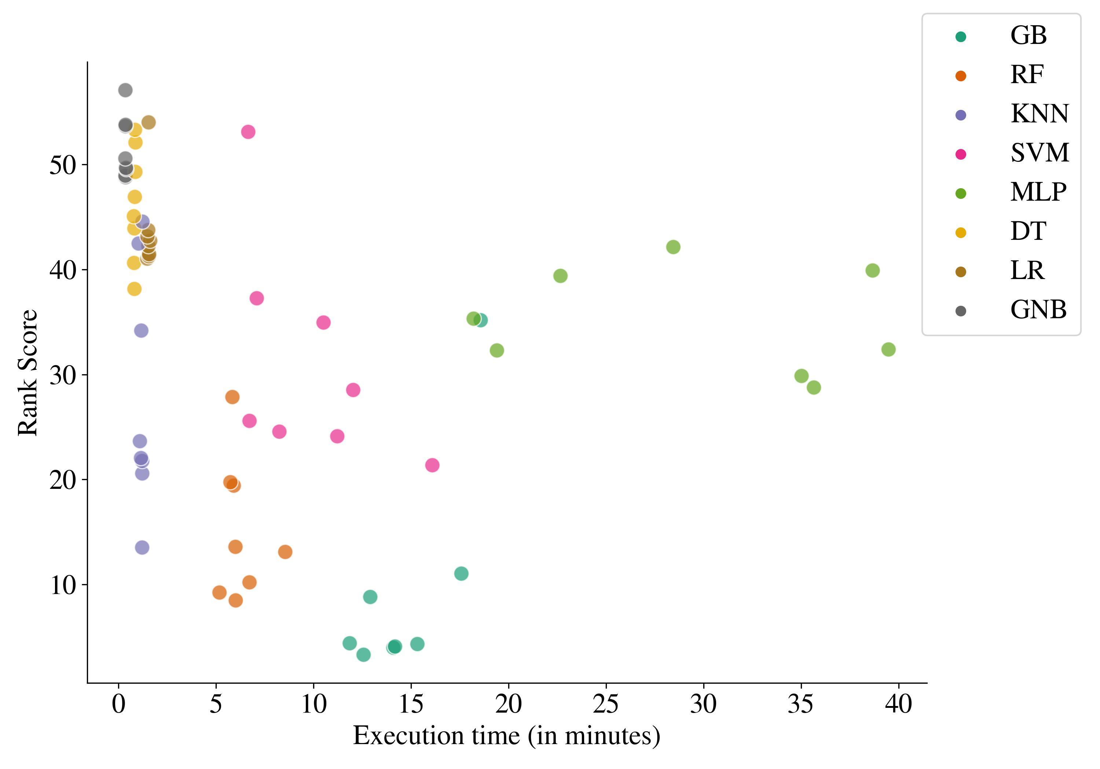
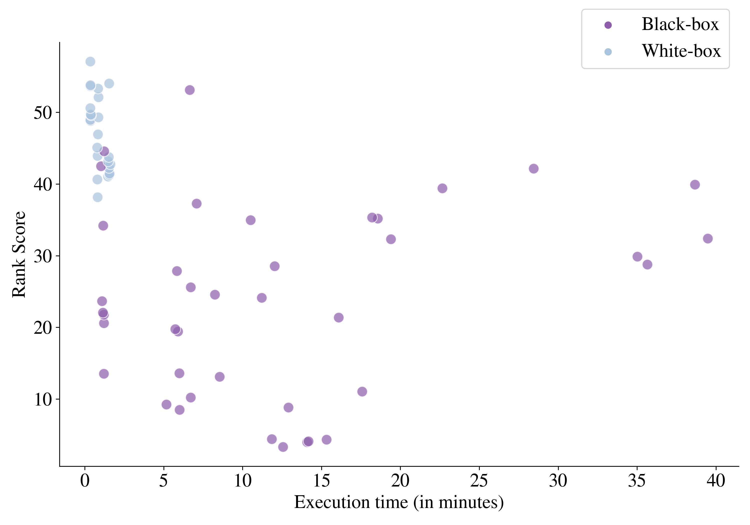
Rank Score vs. Execution Time

Slide 46
Final Model
Gradient Boosting trained on features selected by Neural Network.
Final Features (10): MORTDUE, VALUE, JOB, YOJ, DEROG, DELINQ, CLAGE, NINQ, CLNO, DEBTINC
Threshold: 0.4955
Final Hyperparameters:
Number of estimators: 1,000
Split criterion: Friedman MSE
Max depth of tree: 10
Max features: 1
Loss function: Log Loss
Learning rate: 0.0150

Slide 47
Final Model Recalibration
Instead of using the model trained on training set only → retraining the model on the joined training and validation set.
Model recalibration → improvement in model’s performance.
Threshold recalibration → final threshold: 0.45109
Both recalibrated model and threshold are used within evaluation

Slide 48
Evaluation
Bc. Petr Nguyen
ngup07@vse.cz

Slide 49
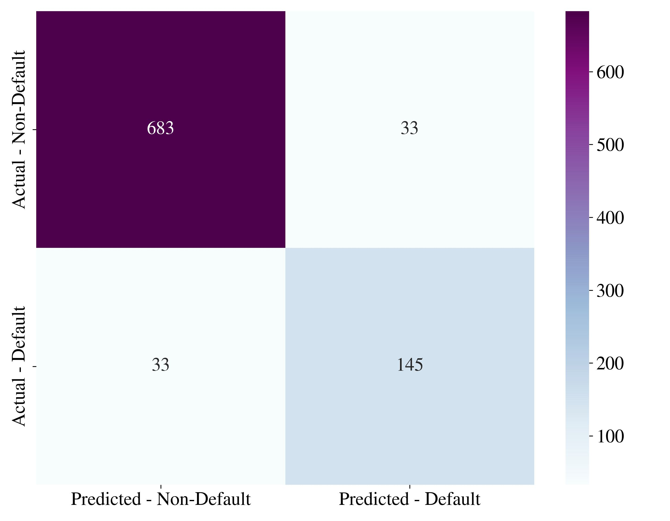
Confusion Matrix

Slide 50
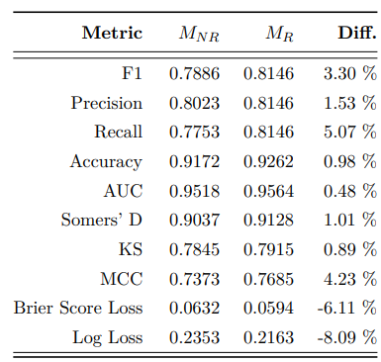
Evaluation Metrics
Relatively high scores (0.8-0.9) and low loss functions → Model is able distinguish between defaulters and non-defaulters.
Positive impact of model recalibration.
Model retrained on training and validation set exhibits higher scores / lower losses than model trained only on training set.

Slide 51
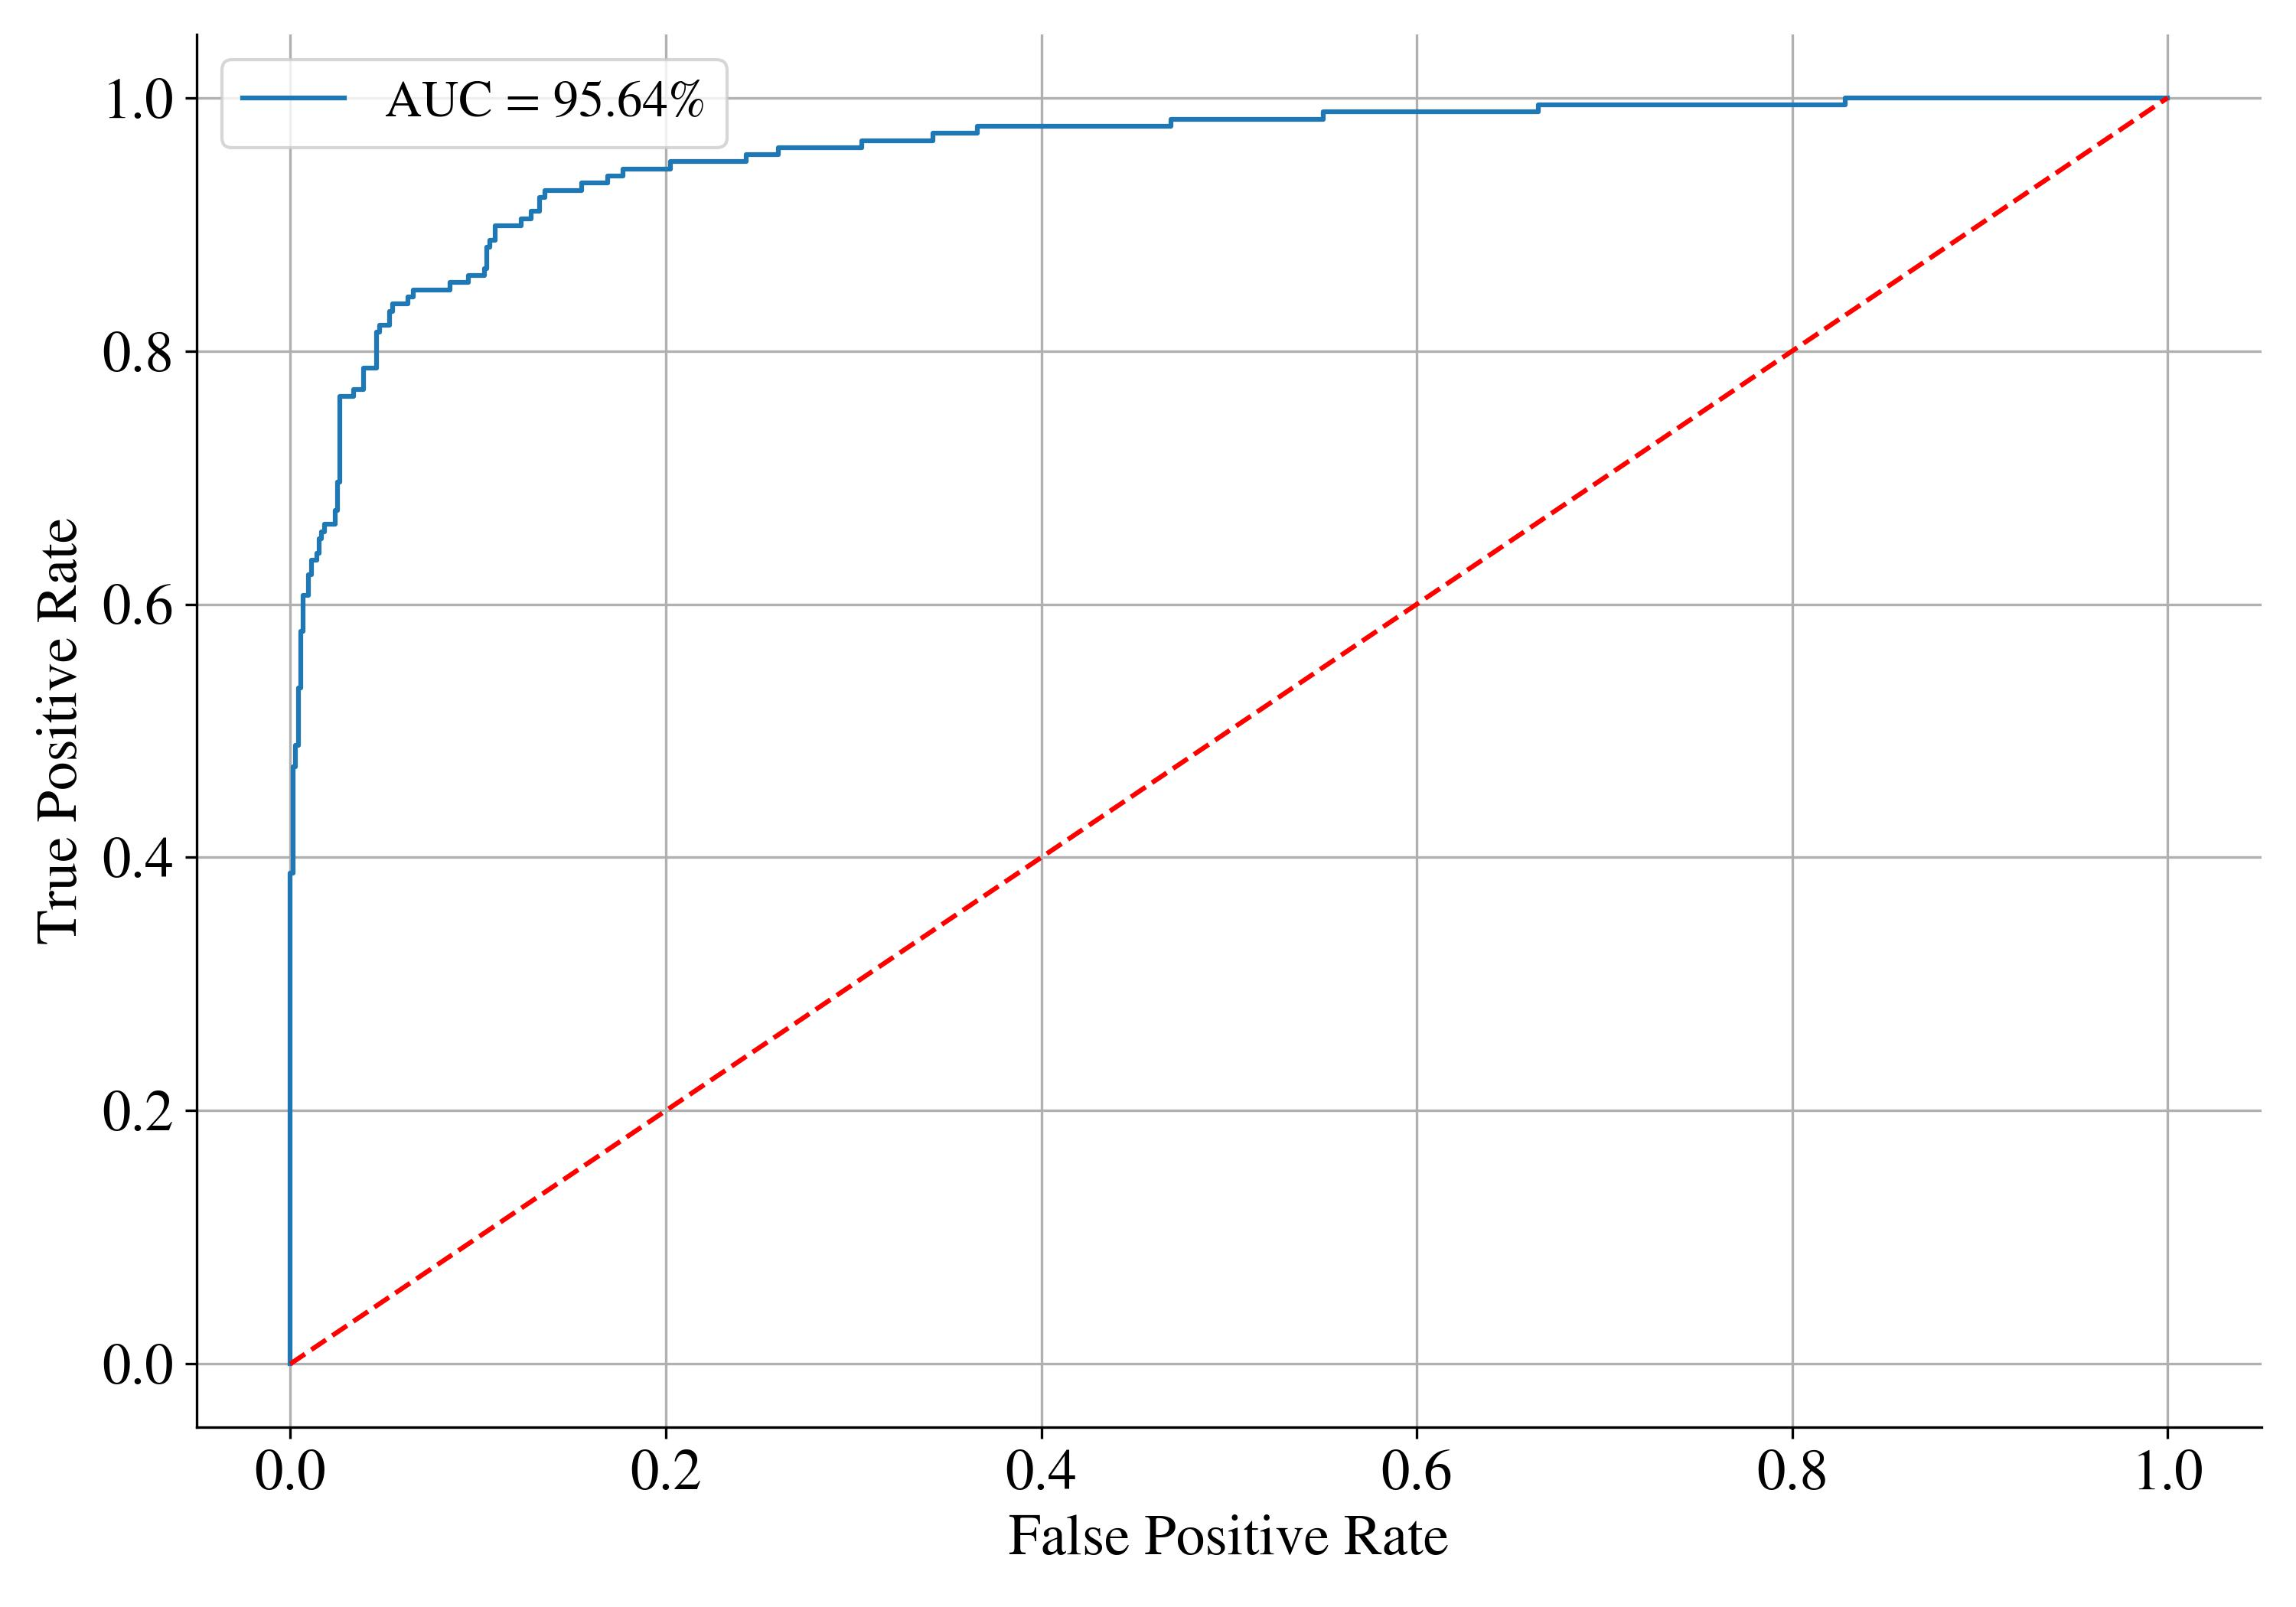
ROC curve of the Gradient Boosting model

Slide 52
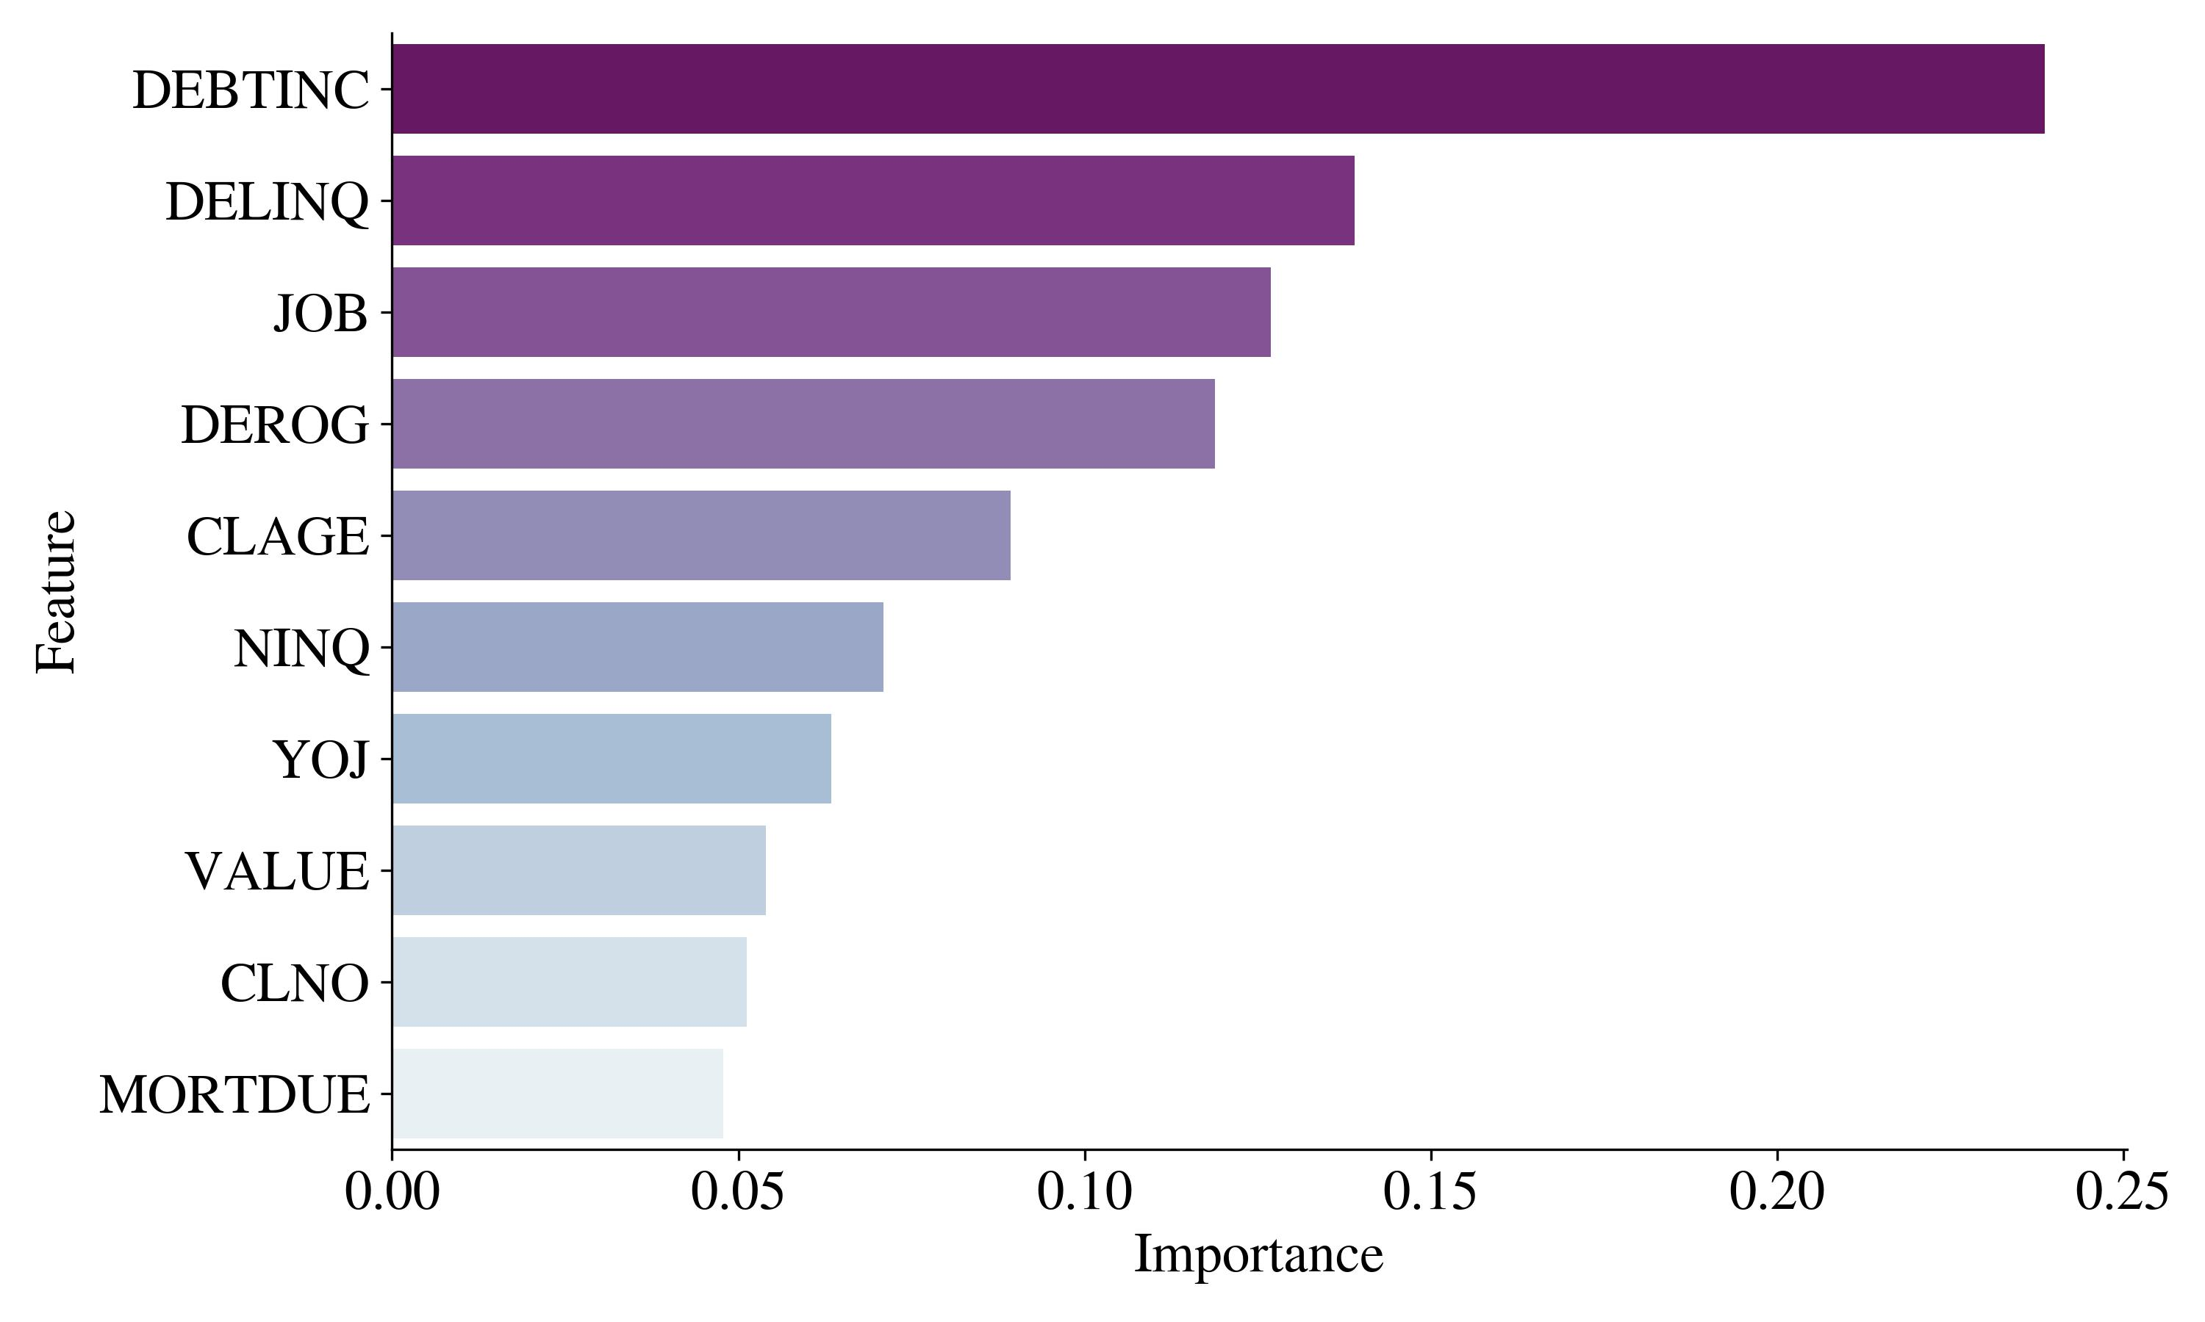
Feature Importance

Slide 53
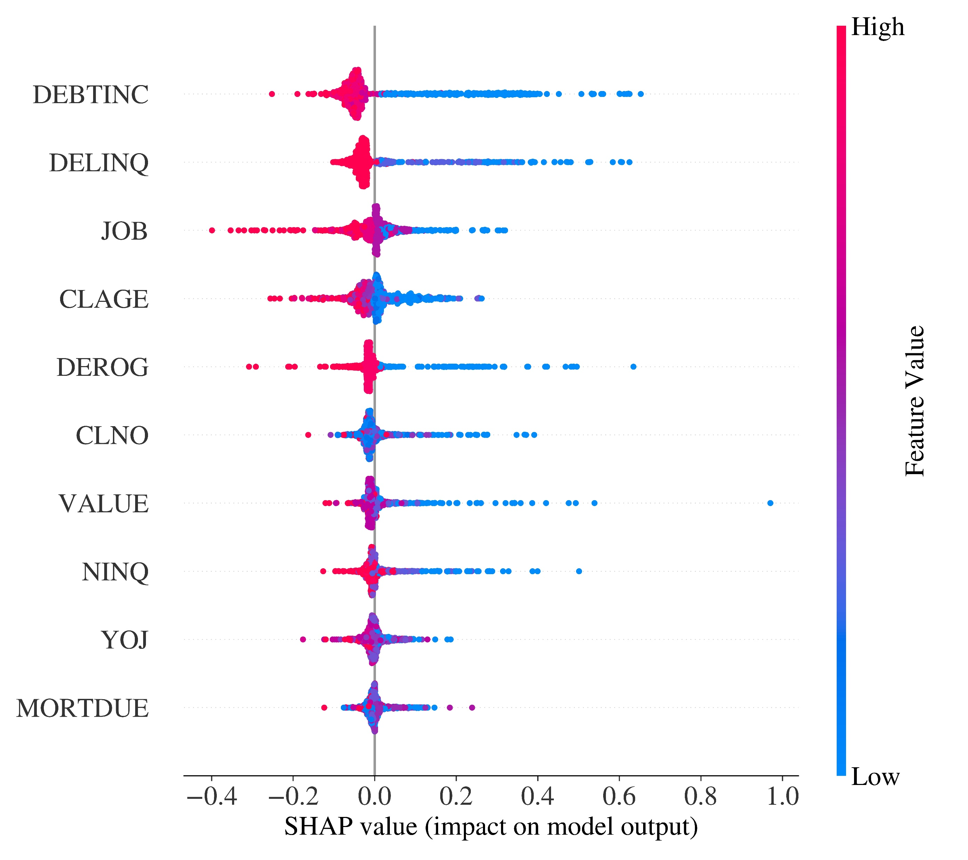
SHAP summary plot of Gradient Boosting model
SHAP values for global explanability of the black box model.
i.e., how each feature contributes to the predictions?
Negative WoE → higher PD
Positive WoE → lower PD

Slide 54
ML Deployment
Bc. Petr Nguyen
ngup07@vse.cz

Slide 55
Machine Learning Deployment
Final model and threshold recalibration prior the deployment on whole data set → final threshold: 0.3358
Web application developed with Flask (back-end) and HTML/CSS (front-end), and deployed on cloud platform PythonAnywhere.
http://ml-credit-risk-app-petrngn.pythonanywhere.com/

Slide 56
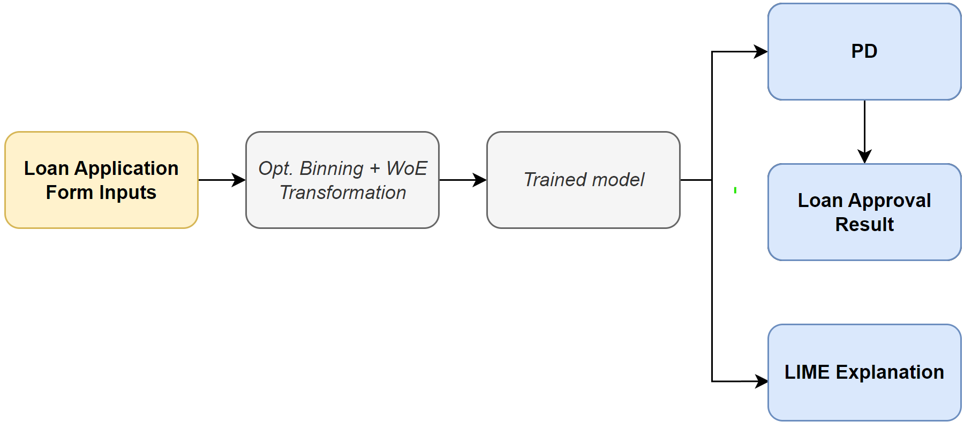
Web Application Architecture

Slide 57
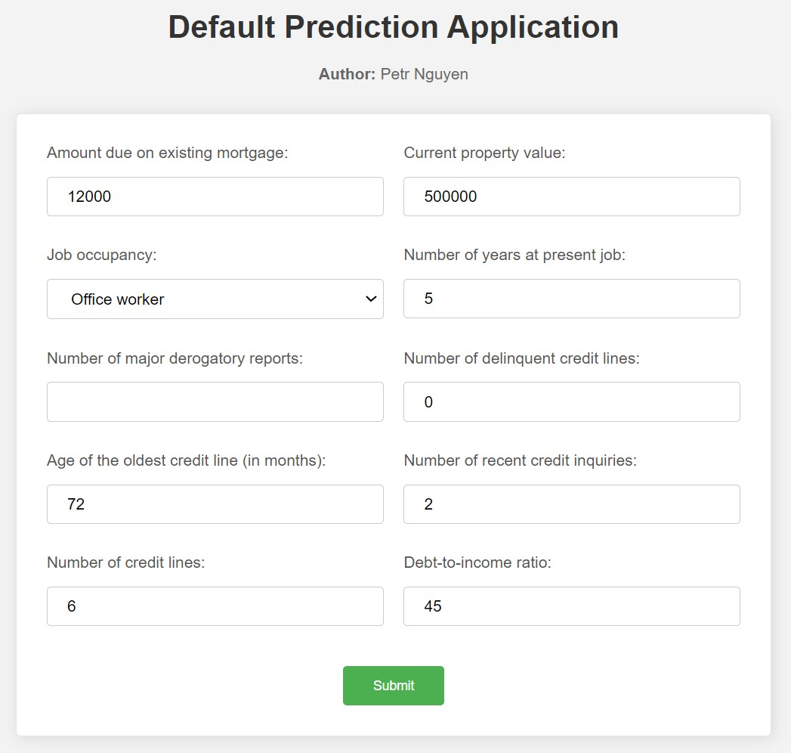
Loan Application Form

Slide 58
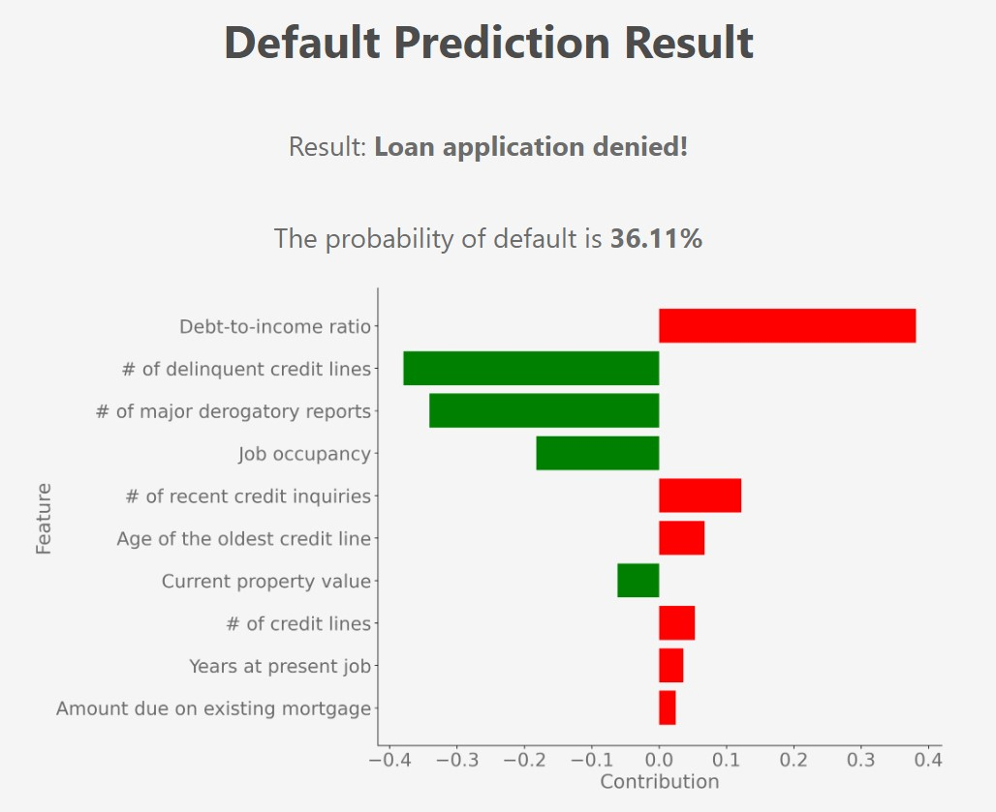
Result Page

Slide 59
Summary of Results
Bc. Petr Nguyen
ngup07@vse.cz

Slide 60
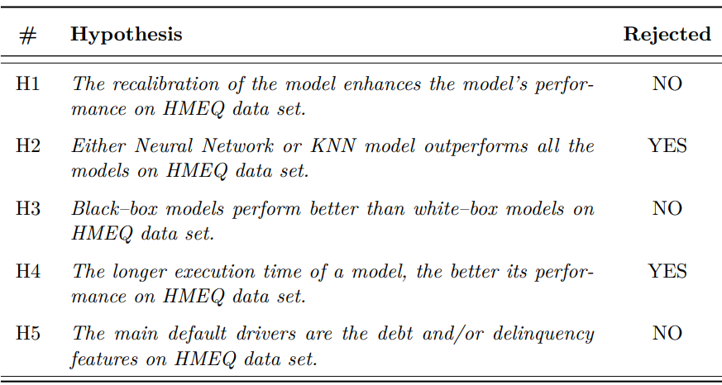
Hypotheses’ Testing

Slide 61
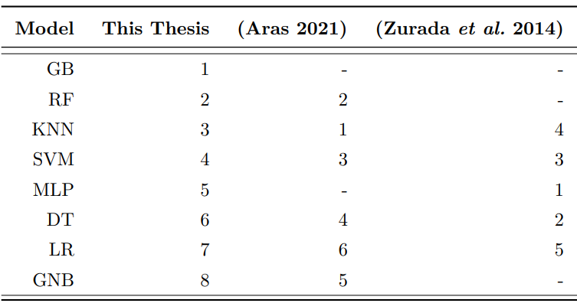
Comparison with HMEQ studies

Slide 62
Another Key Findings
ADASYN generates more synthetic default-case instances that are managers.
Missing Debt-to-income ratio is strong indicator of default.
Despite the strong association between VALUE and default status, its contribution is negligible.
Black-box models tend to select more features than white box models.
Despite the high correlation between VALUE and MORTDUE, both features were selected within the final model.
Most of the models are conservative as they have threshold below 0.5
Ensembles GB, RF performs better than SVM, NN, and LR, DT and GNB perform the worst.
Drawback of Youden index for optimal threshold calculation resulting in threshold of 1.

Slide 63
Recommendations
Use more relevant, actual and „bigger“ data
Use behavioral scoring and macroeconomic data
Use TensorFlow/Keras/PyTorch for Neural Network development
Use Django framework for ML deployment
ML application in other credit risk modelling components (LGD, EAD, ECL)
Hyperparameter Optimization with Optuna
H2O ML module for automated machine learning
Constraints for threshold optimization

Slide 64
Contributions
Own versatile ML implementation framework developed in Python and HTML/CSS.
Advanced modelling approaches such as ADASYN, OptBinning, Bayesian Optimization, recalibration, optimal threshold calculation using Youden index.
Development of custom feature selection and model selection algorithms and assessment of black-box model explainability.
Development of web application.

Slide 65
Questions
Bc. Petr Nguyen
ngup07@vse.cz

Slide 66
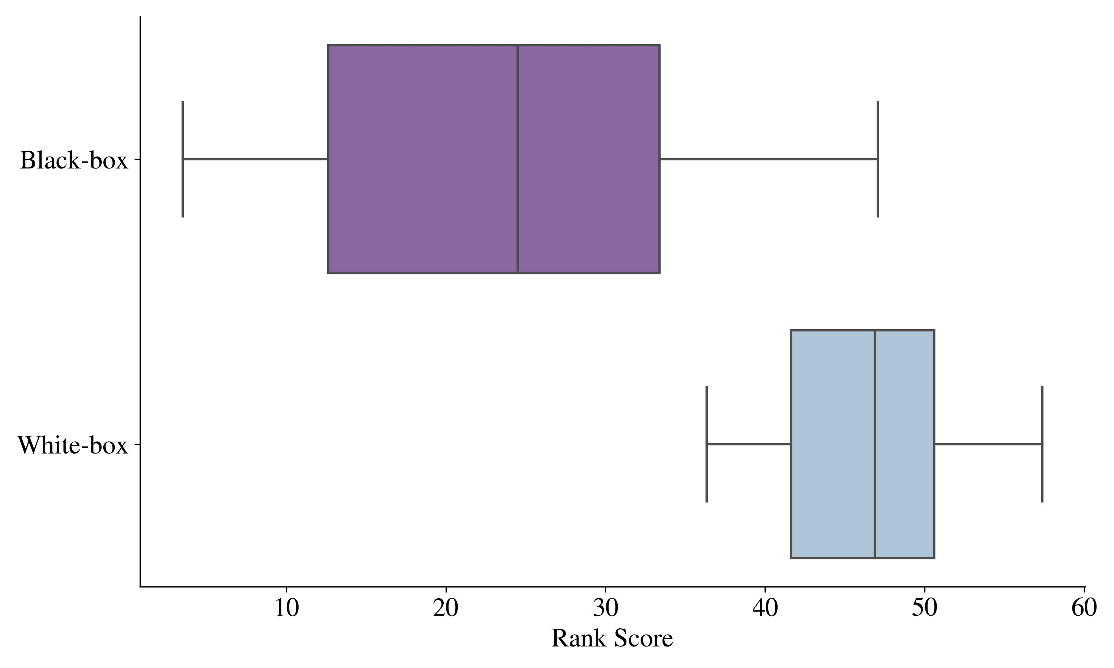
Supervisor’s Questions
prof. PhDr. Petr Teplý, Ph.D:
Could Petr spend few words on the results of Hypothesis 3 “Black-box models perform better than white-box models on the HMEQ data set”?

Slide 67
Supervisor’s Questions
prof. PhDr. Petr Teplý, Ph.D:
What are the specific policy recommendation for risk managers and regulators based on Petr’s results regarding the recent banking regulatory framework (specifically the use of internal bank models)?
EBA (2021): Discussion paper on machine learning for IRB models
Precise methodology and governance for documentation, modelling, deployment, validation, monitoring
Precise, comprehensible and consistent documentation (modelling, assumptions, math. theory)
Intuitive and interpretable model’s results in line with economic theory
Explainability of model’s results → LIME, SHAP, Feature Importance
All the stakeholders should have appropriate level of knowledge of model’s functioning
EBA (2021) – Discussion paper on machine learning for IRB models
All the stakeholders should have appropriate level of knowledge of model’s functioning
CRM staff should have high skill level for development and validation of ML models.
Avoid unnecessary complexity
Human judgement
Fairness and no bias / discrimination → ethical and legal aspects
Regular monitoring, validation and recalibration
Data quality and representativeness

Slide 68
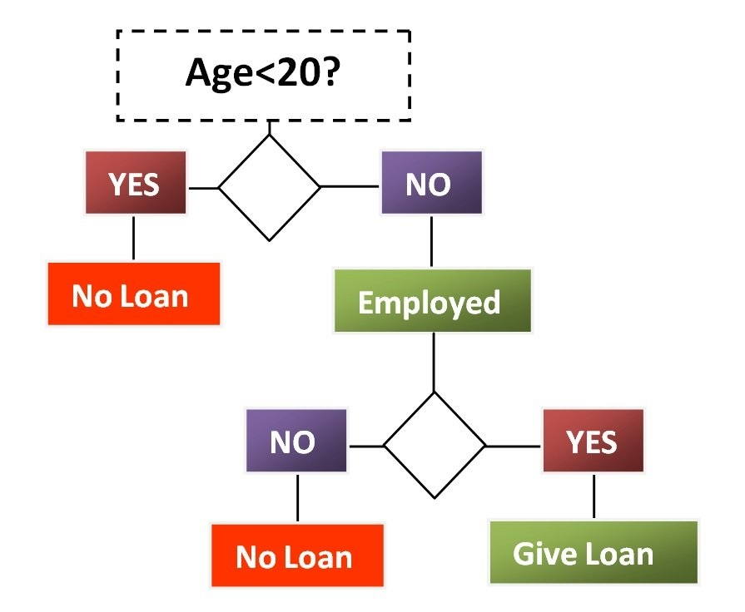
Opponent’s Questions
Ing. Luděk Palán:
Which modelling approach according to your experience does provide the best balance between final model performance and the level of understandability for decision makers?
Sufficient comprehensibility (if the tree is not too deep)
Plausible performance due to:
Non-parametric character of decision tree
Robustness against outliers and non-linear relationships

Slide 69
References
Aras, S. (2021): “Bagging and Boosting Classifiers for Credit Risk Evaluation.” Reflection of Economic Development
de Hond, A. A., I. M. Kant, M. Fornasa, G. Cinà, P. W. Elbers, P. J. Thoral, M. S. Arbous, & E. W. Steyerberg (2023): “Predicting Readmission or Death After Discharge From the ICU: External Validation and Retraining of a Machine Learning Model.” Critical Care Medicine
Drahokoupil, J. (2022): “Application of the XGBoost algorithm and Bayesian optimization for the Bitcoin price prediction during the COVID-19 period.” FFA Working Papers 4
EBA (2021): “Discussion paper on machine learning for IRB models”. European Banking Authority.
Morocho-Cayamcela M.E., H. Lee & W. Lim (2019): “Machine Learning for 5G/ B5G Mobile and Wireless Communications: Potential, Limitations, and Future Directions”. Institute of Electrical and Electronics Engineers
Pintelas, E., I. E. Livieris, & P. Pintelas (2020): “A Grey-Box Ensemble Model Exploiting Black-Box Accuracy and White-Box Intrinsic Interpretability.” Algorithms
Wu, Z., L. Jiang, Z. Jiang, B. Chen, K. Liu, Q. Xuan, & Y. Xiang (2018): “Accurate indoor localization based on CSI and visibility graph.” Sensors (Basel, Switzerland)
Zurada, J., N. Kunene, & J. Guan (2014): “The classification performance of multiple methods and datasets: Cases from the loan credit scoring domain.” Journal of International Technology and Information Management

Slide 70
Thank for your attention
Bc. Petr Nguyen
ngup07@vse.cz

